Slide 1
How to Tell How Far Away You Are: Metrics and Topology
Ethan Scheelk

Slide 2
Outline
An intro to topology
Distill properties of objects
A taste of persistent homology
How to measure distance, definition of a metric
A method to measure the similarity or distance between objects
Homology
Study the shape of data
Compare how metrics impact that shape

Slide 3
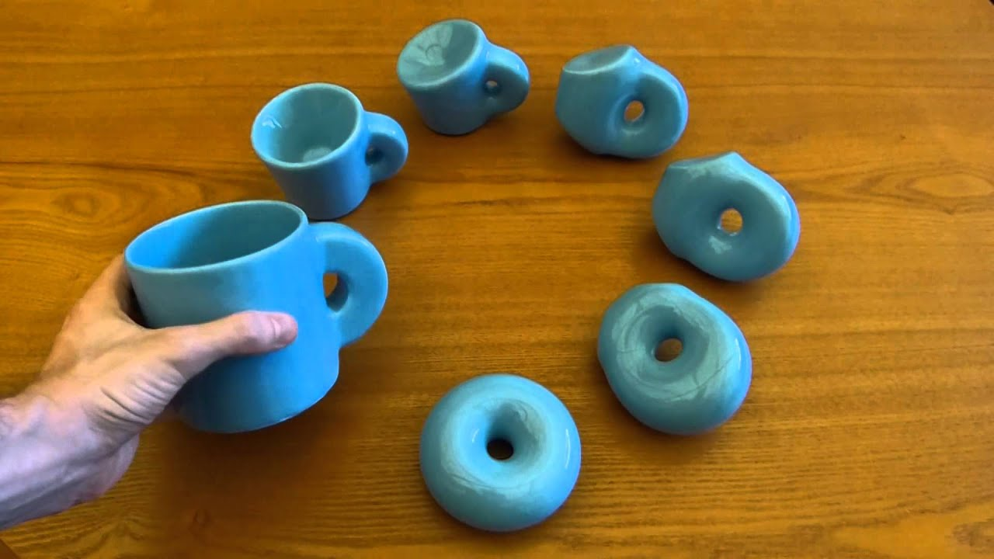
A cursory glance at topology
A way to distill properties of “objects,” spaces, or groups
For example, the coffee cup and donut
Or a point cloud
Henry Segerman

Slide 4
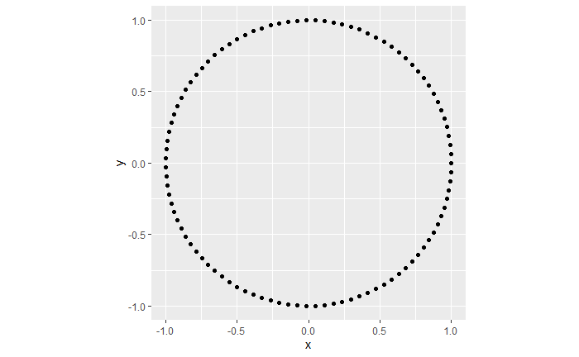

Slide 5


Slide 6
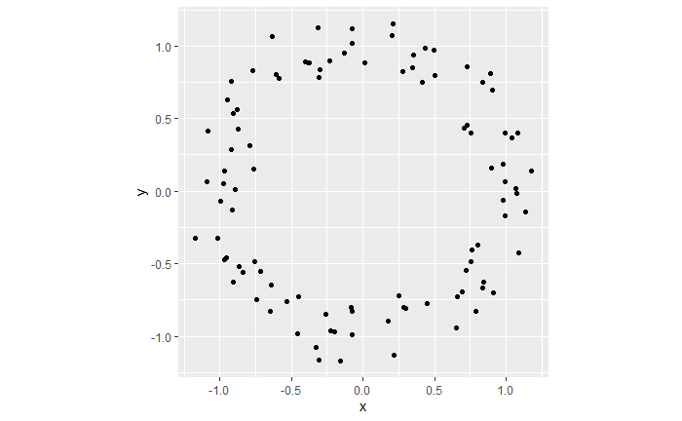

Slide 7
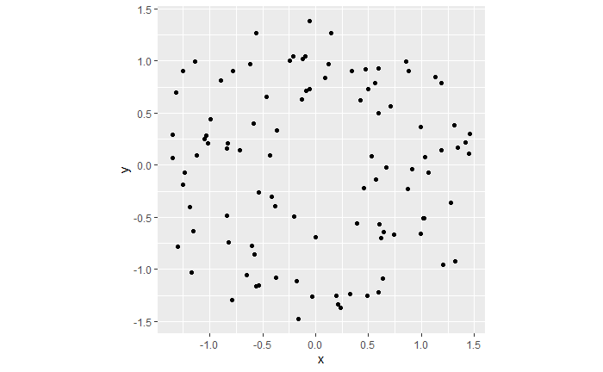

Slide 8
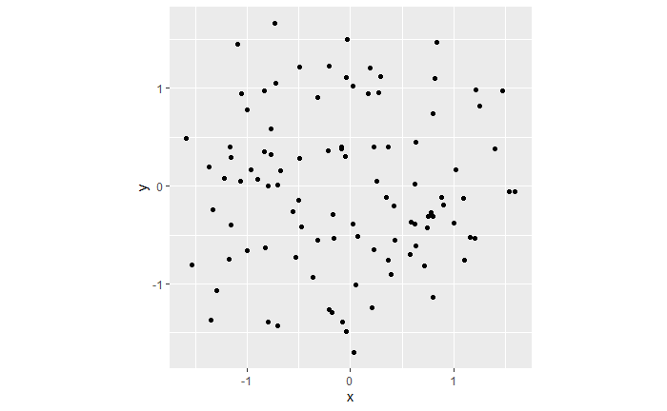

Slide 9
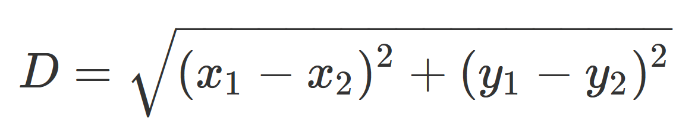
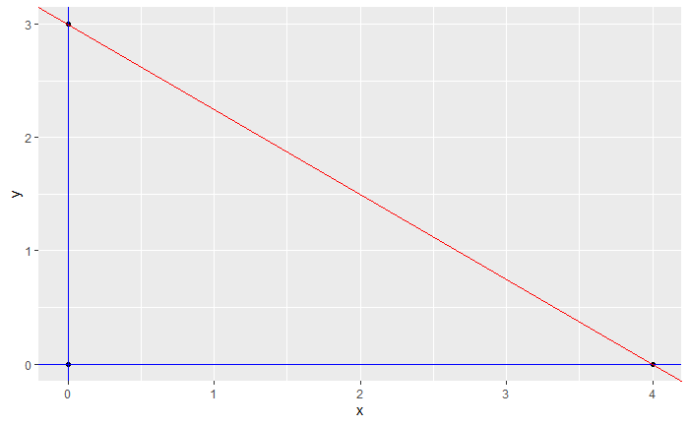

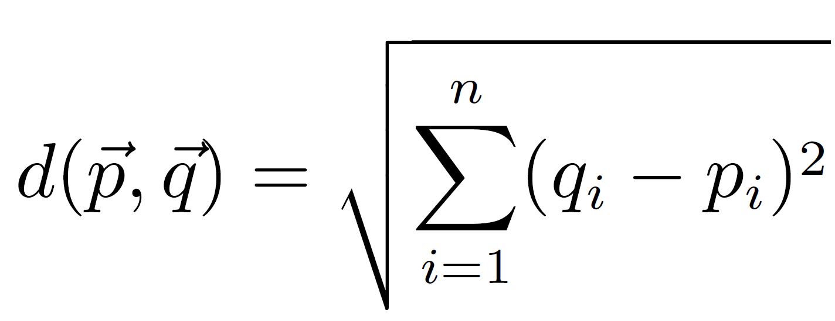
Metrics
A way to measure distance between objects

Slide 10
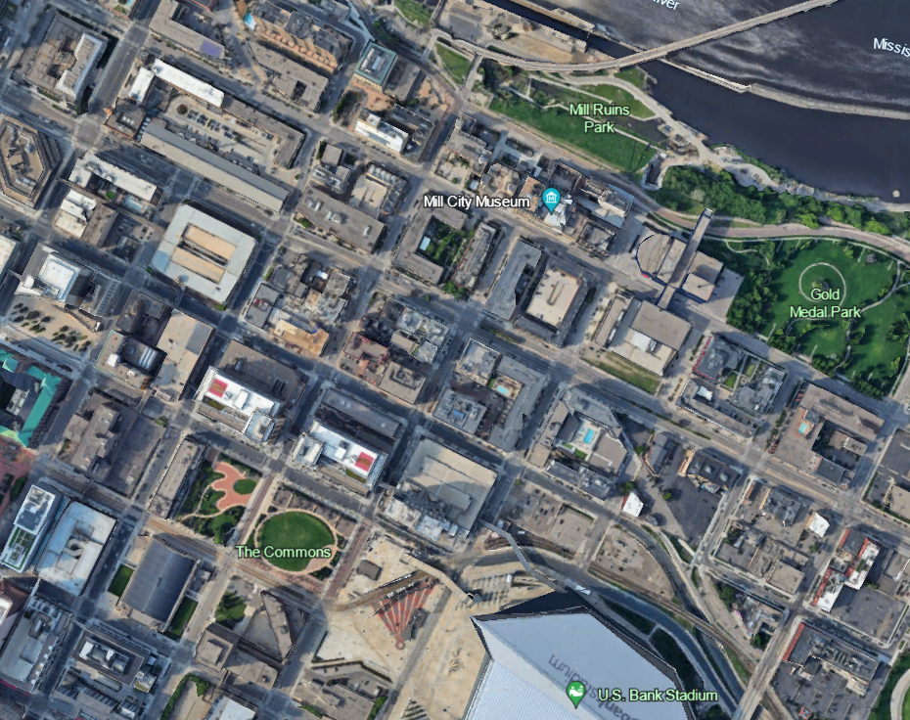
The Guthrie
The Armory
Google Earth

Slide 11
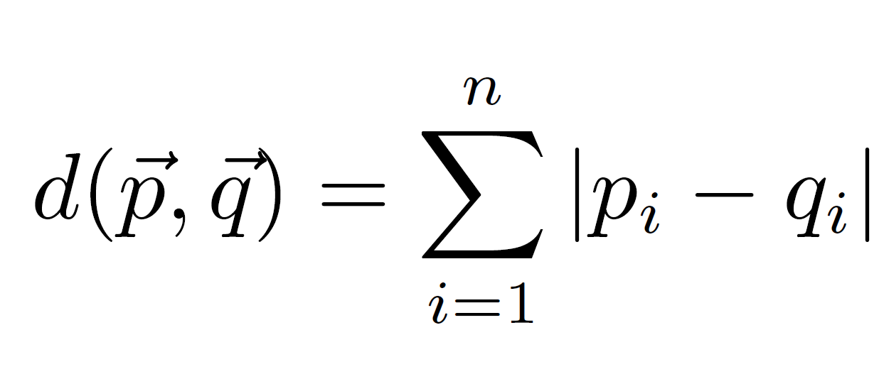
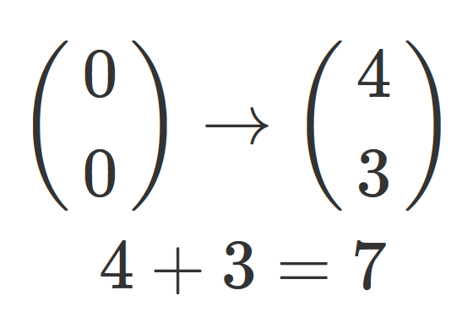
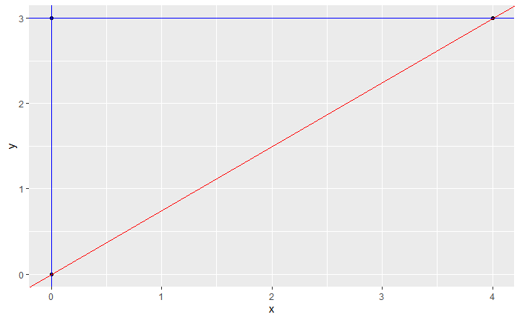
City-Block Metric
The sum of the distances you must walk in each dimension

Slide 12

City-Block Metric
The sum of the distances you must walk in each dimension

Slide 13
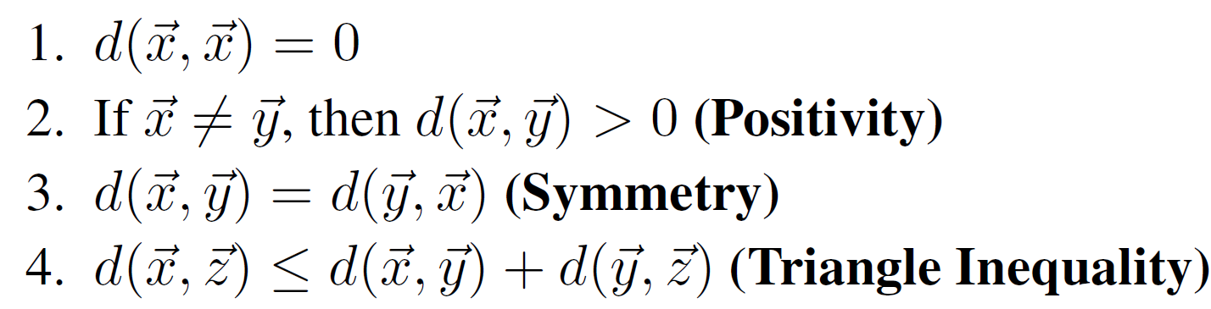
Rules for Metrics

Slide 14
Rules for Metrics

Slide 15

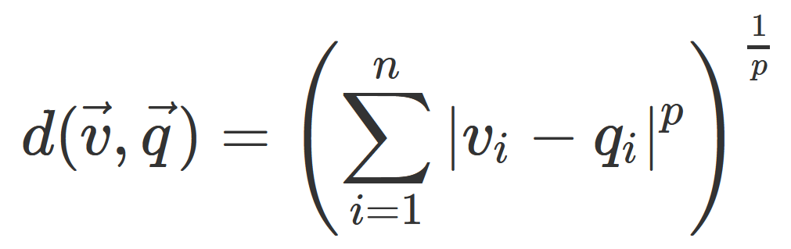
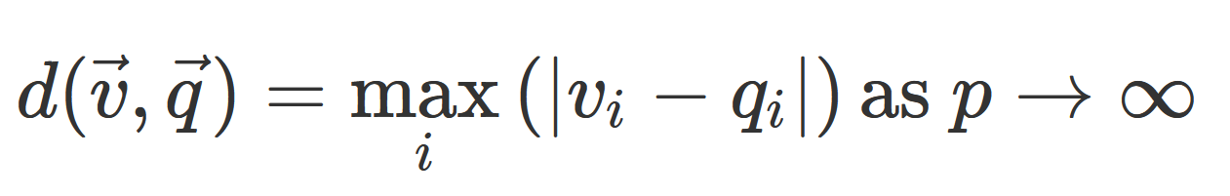
Minkowski / p-norms

Slide 16
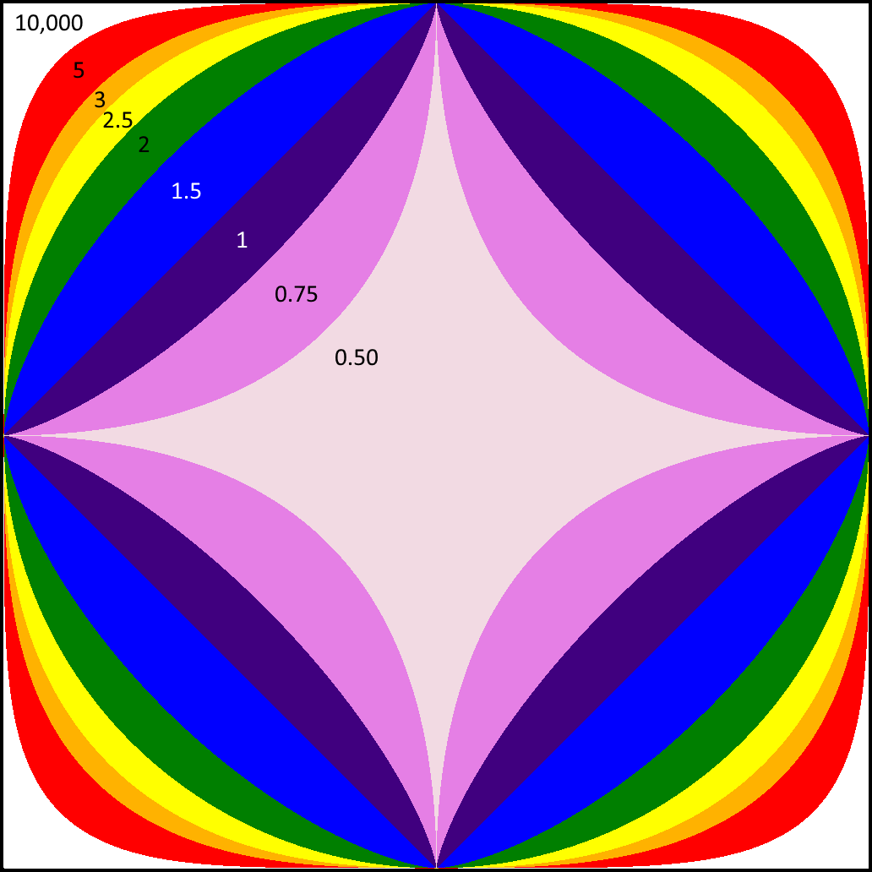

Slide 17


Homology
Observation on inherent differences and similarities between some “shapes” or groups

Slide 18
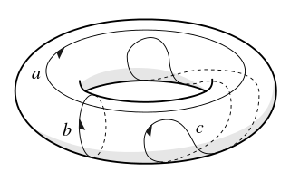
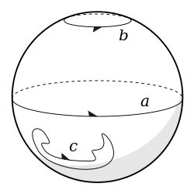
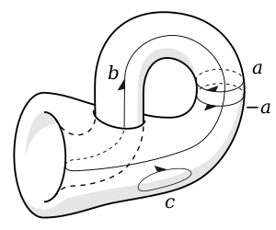

Slide 19

Hjornbeck, Wikimedia Creative Commons License https://commons.wikimedia.org/wiki/File:Simplexes.jpg#Licensing

Slide 20
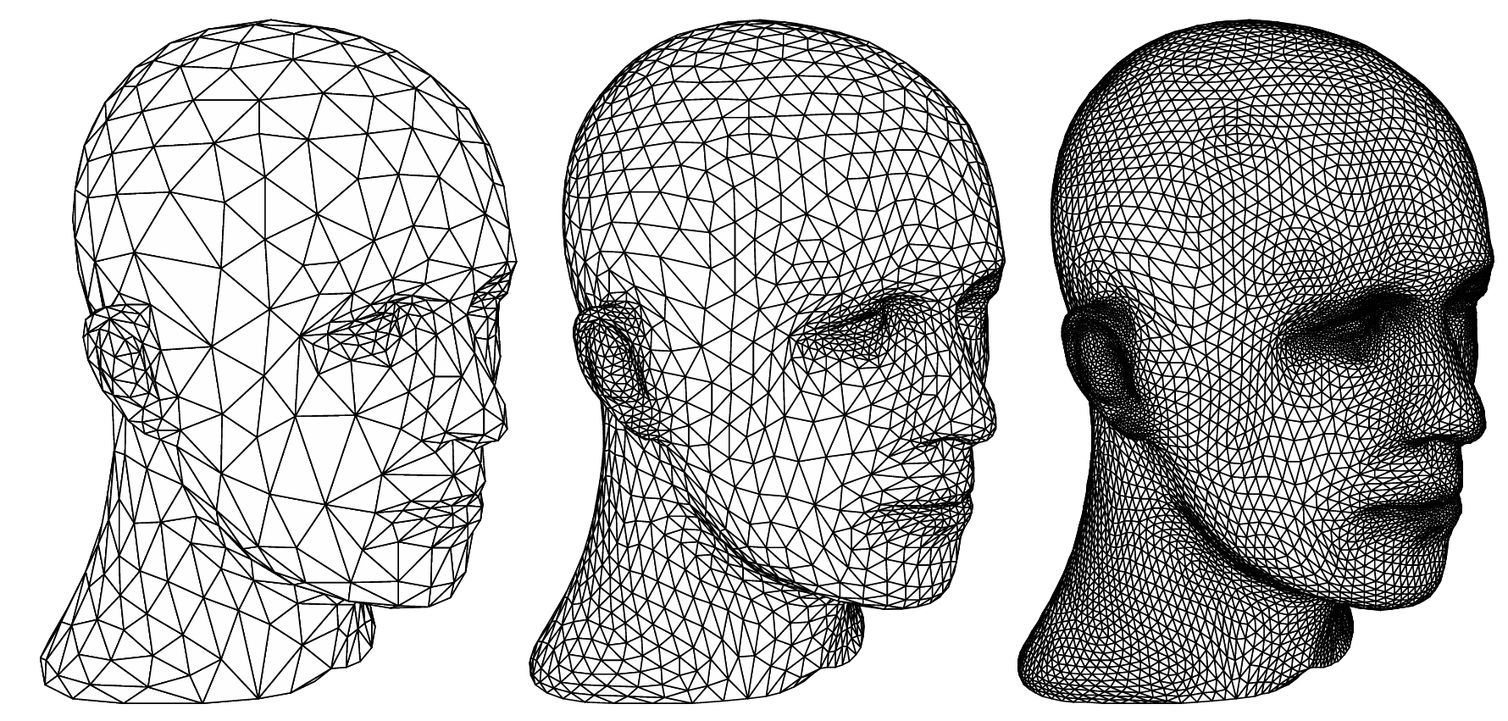
Zorin and Schroder, 2000. Subdivision for Modeling and Animation. SIGGRAPH 2000.

Slide 21
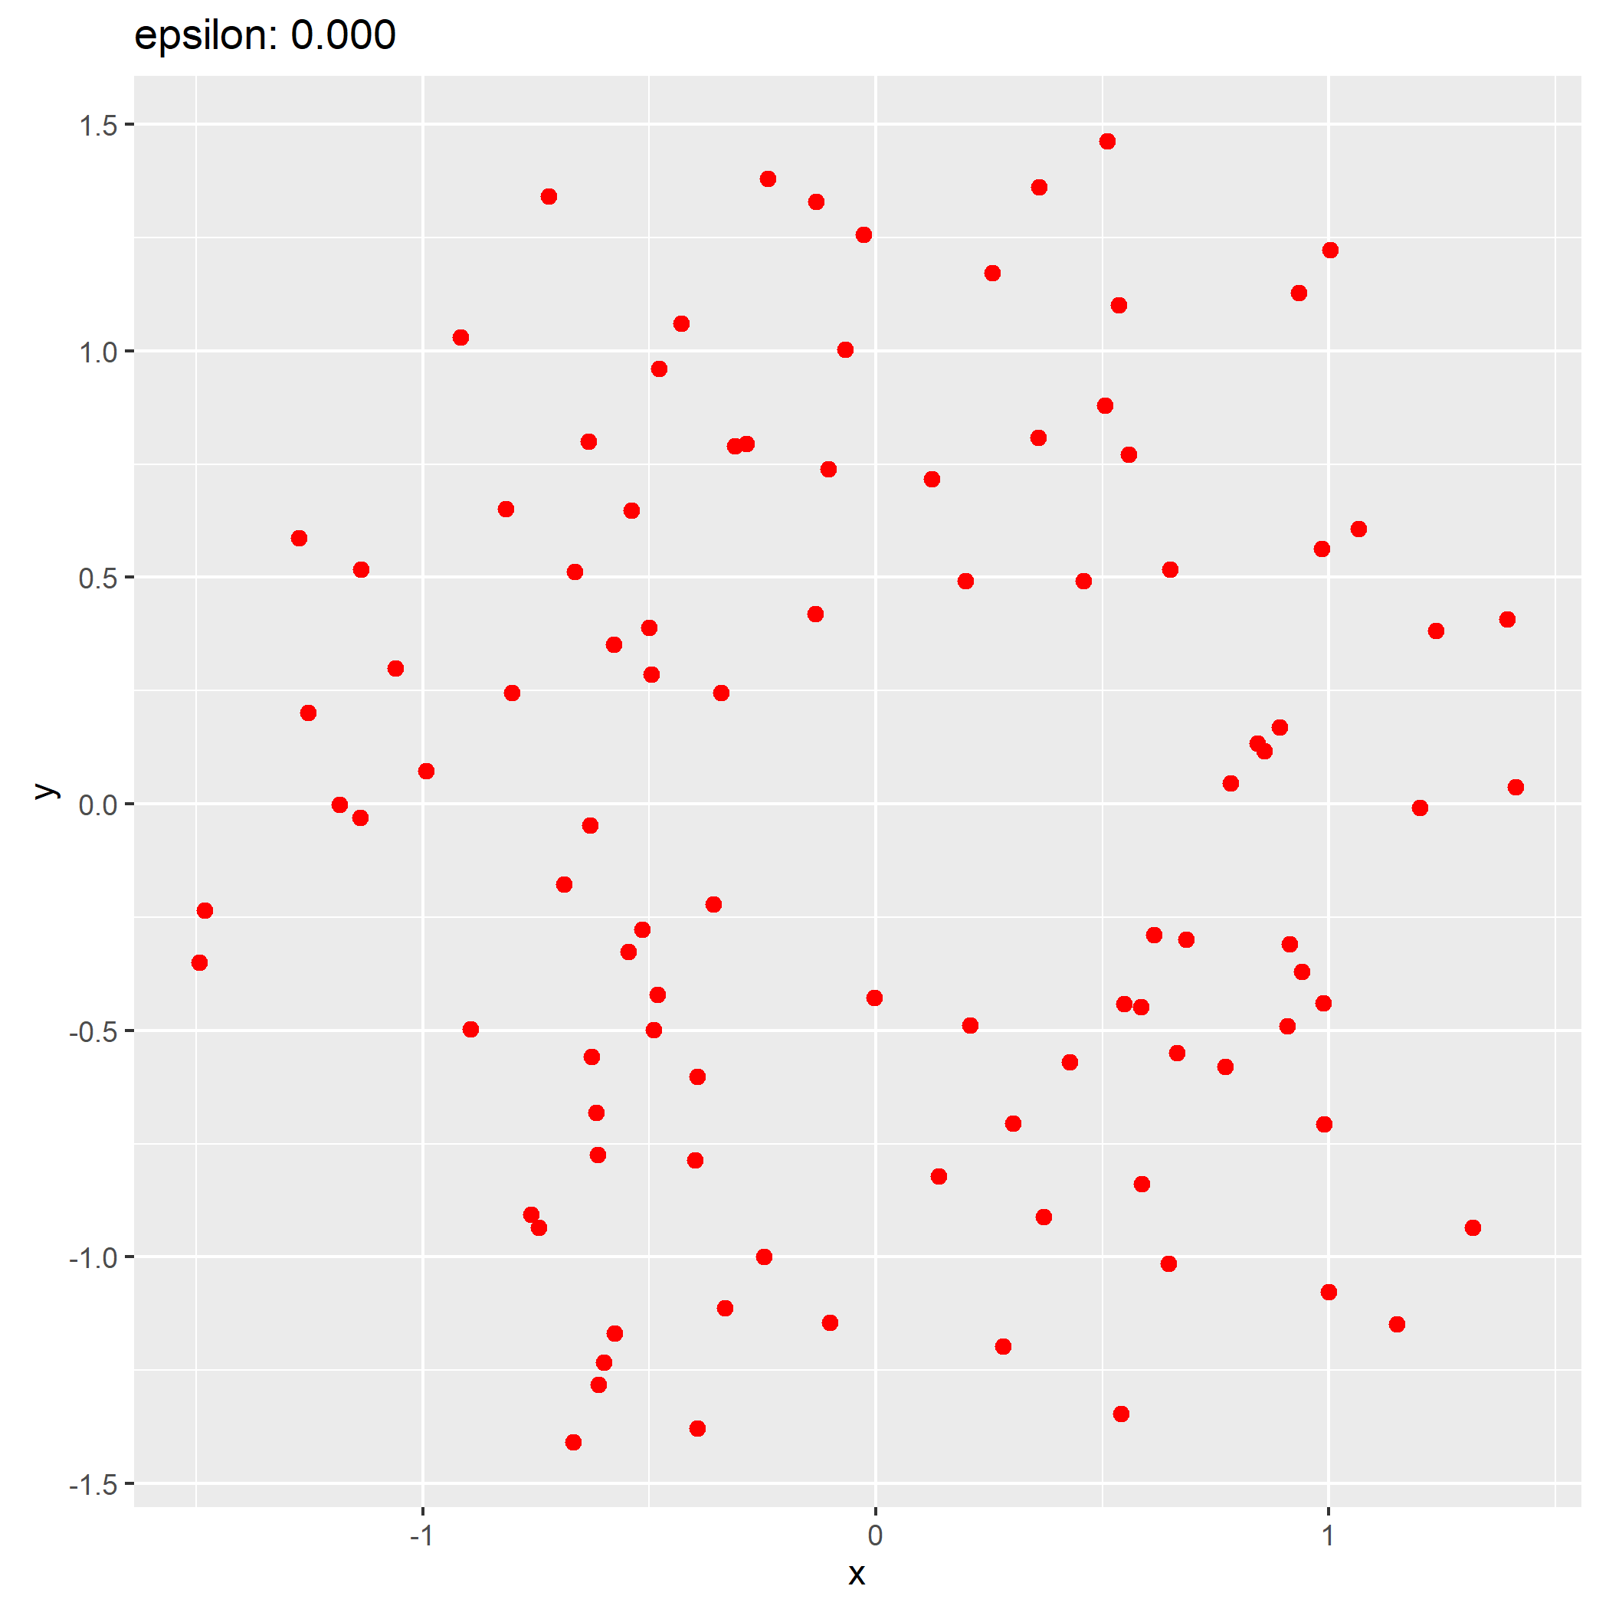
Some assumptions we’ll make:
There is an algorithm which will connect points below some distance threshold we’ll call ϵ (Vietoris-Rips or Cech Complex) and make a simplicial complex.
There is an algorithm which can find the homological properties of a simplicial complex (object, holes, voids)

Slide 22
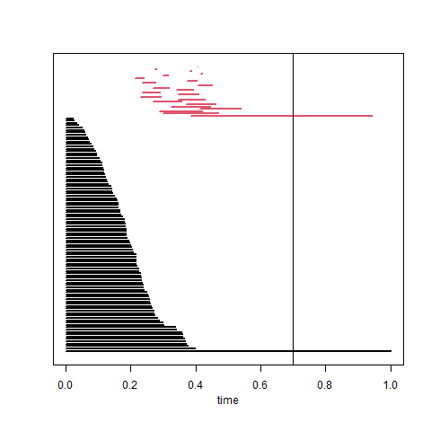
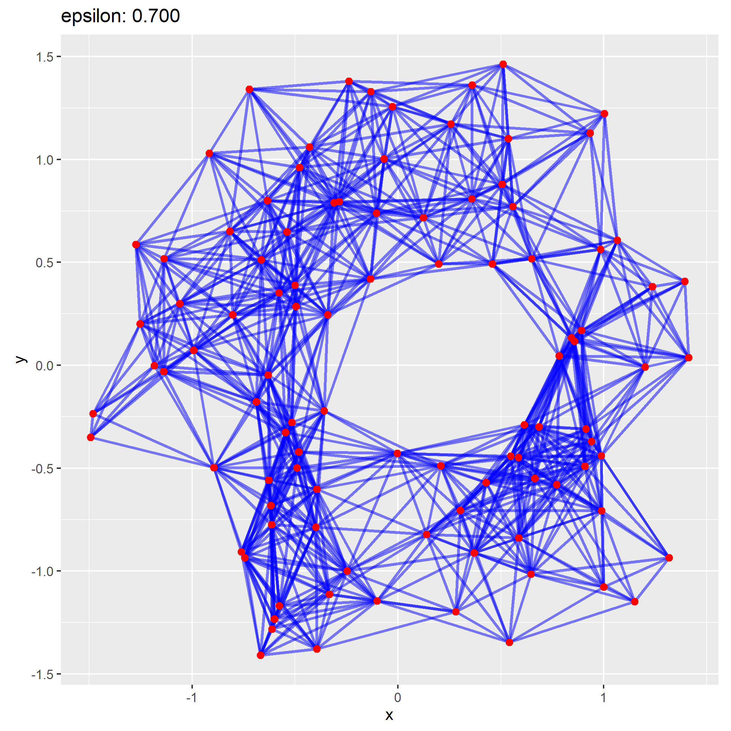
Barcode, Persistence Diagram

Slide 23

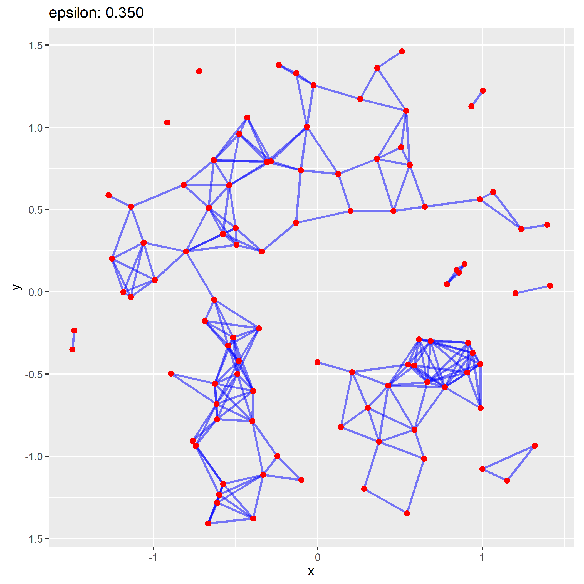
Another barcode example

Slide 24


Slide 25



Slide 26

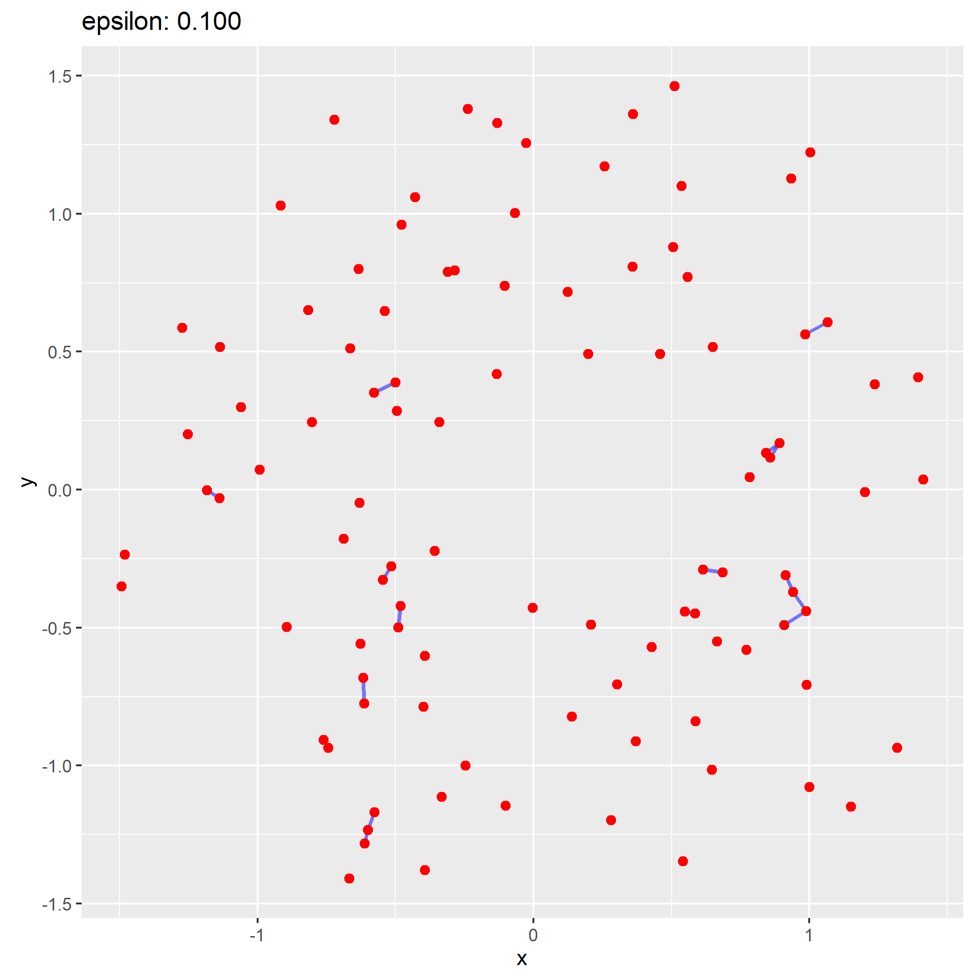

Slide 27

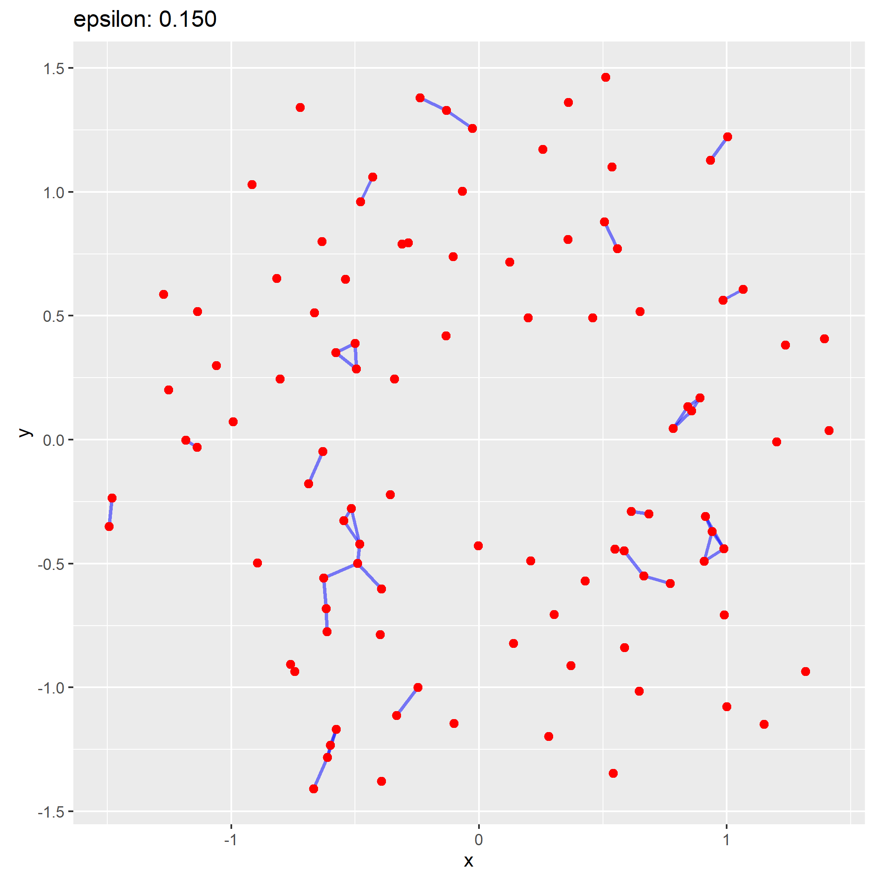

Slide 28
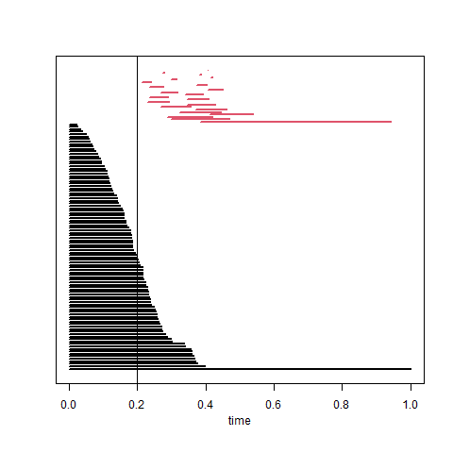
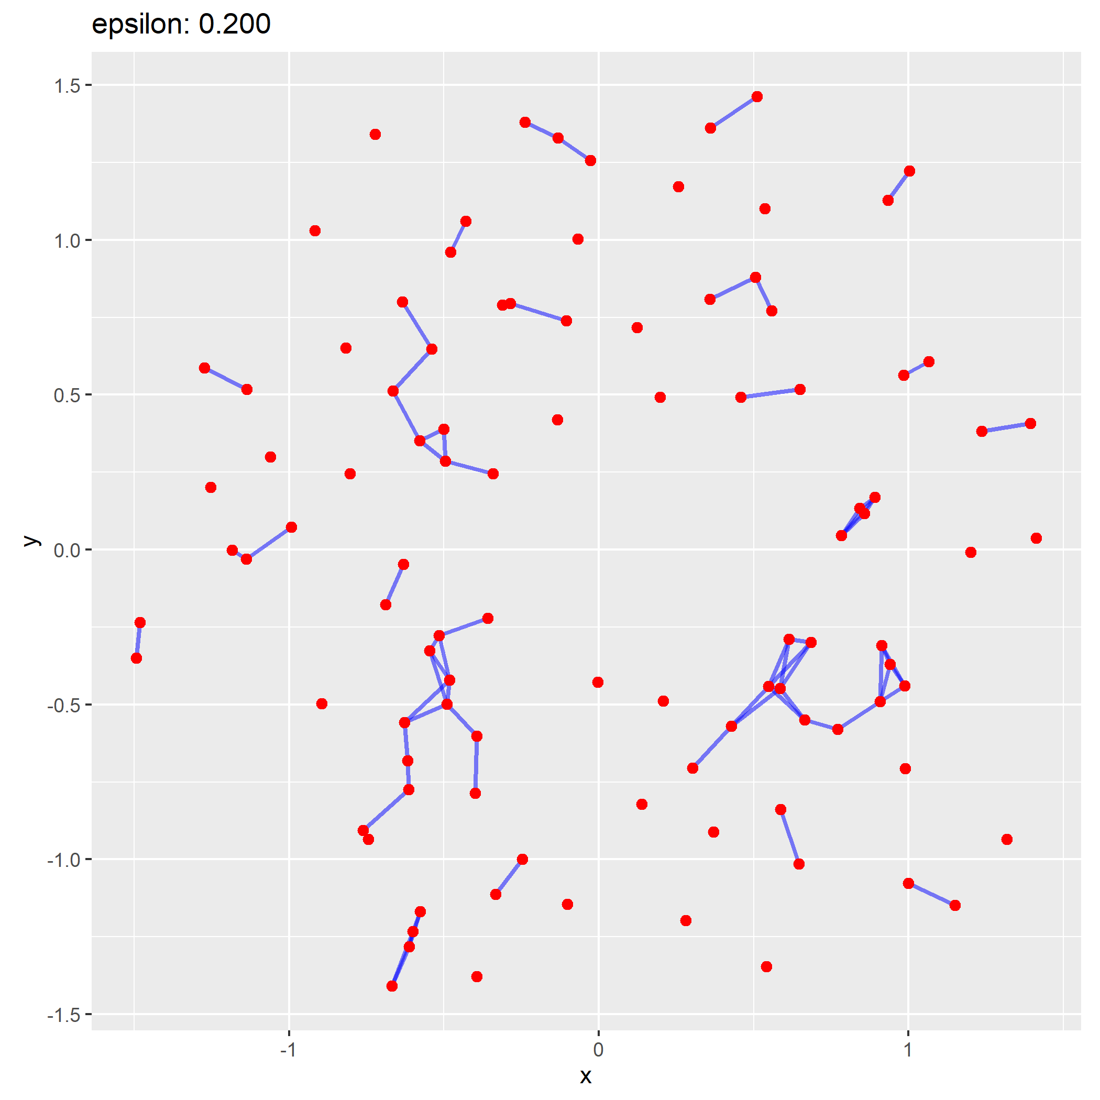

Slide 29

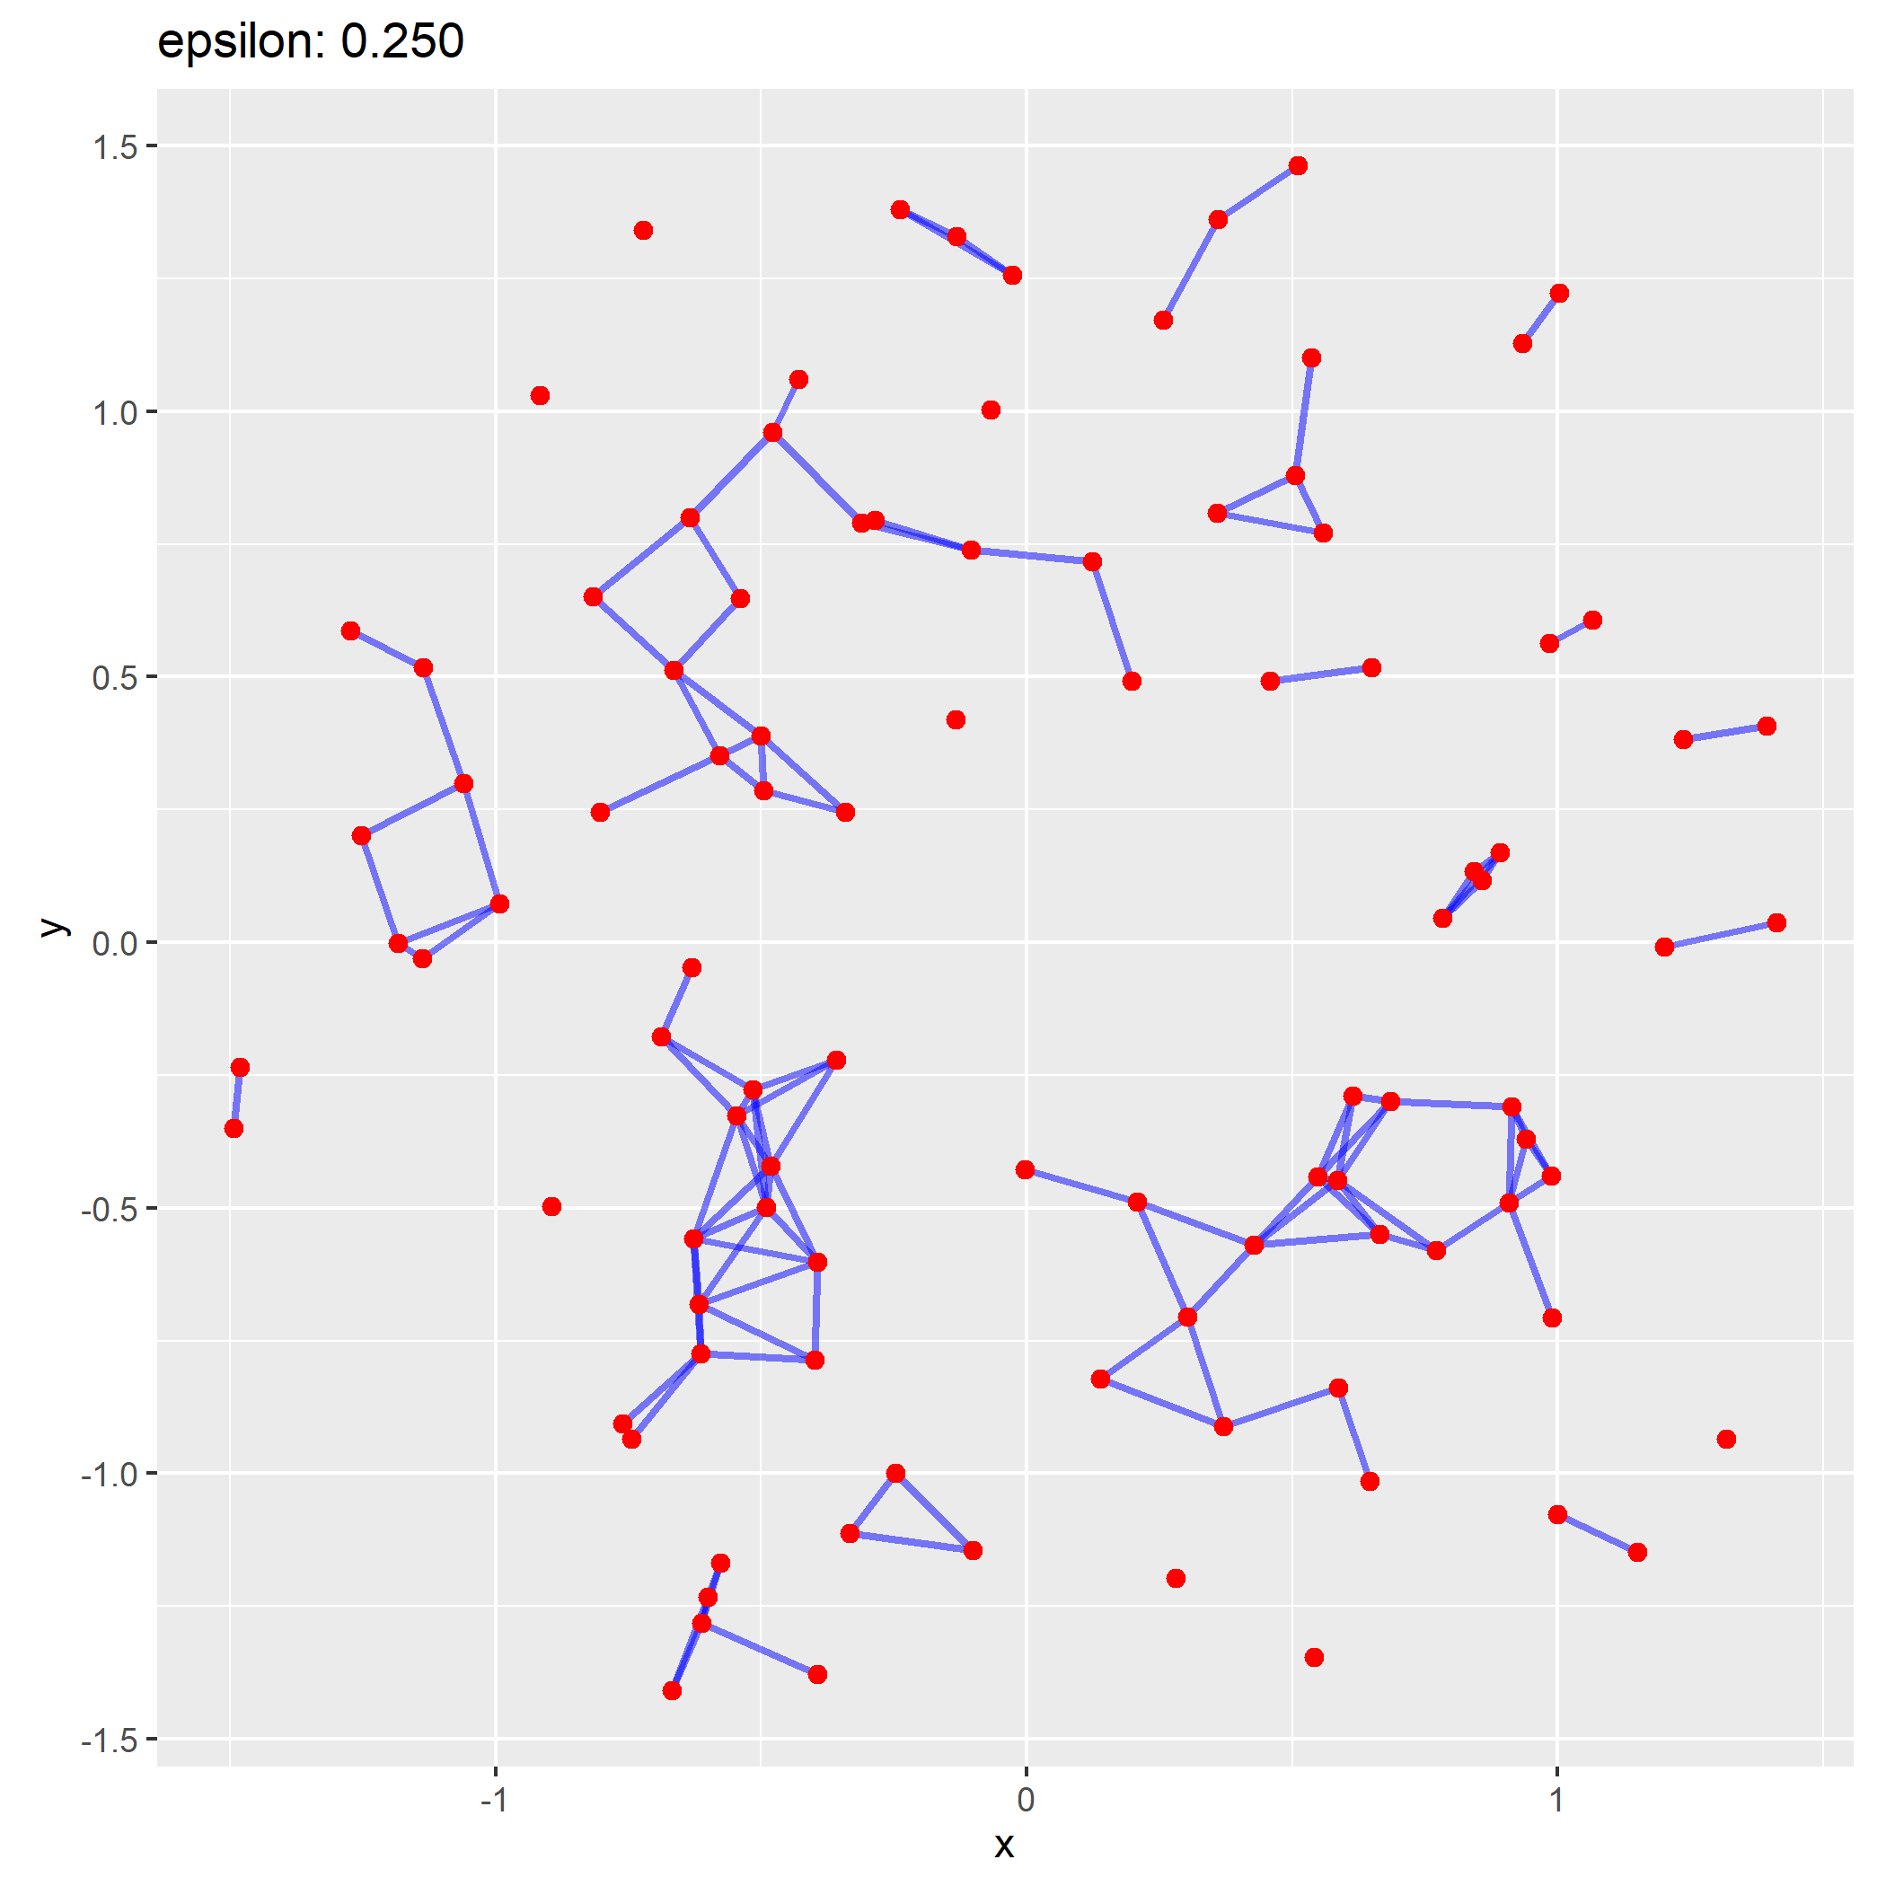

Slide 30

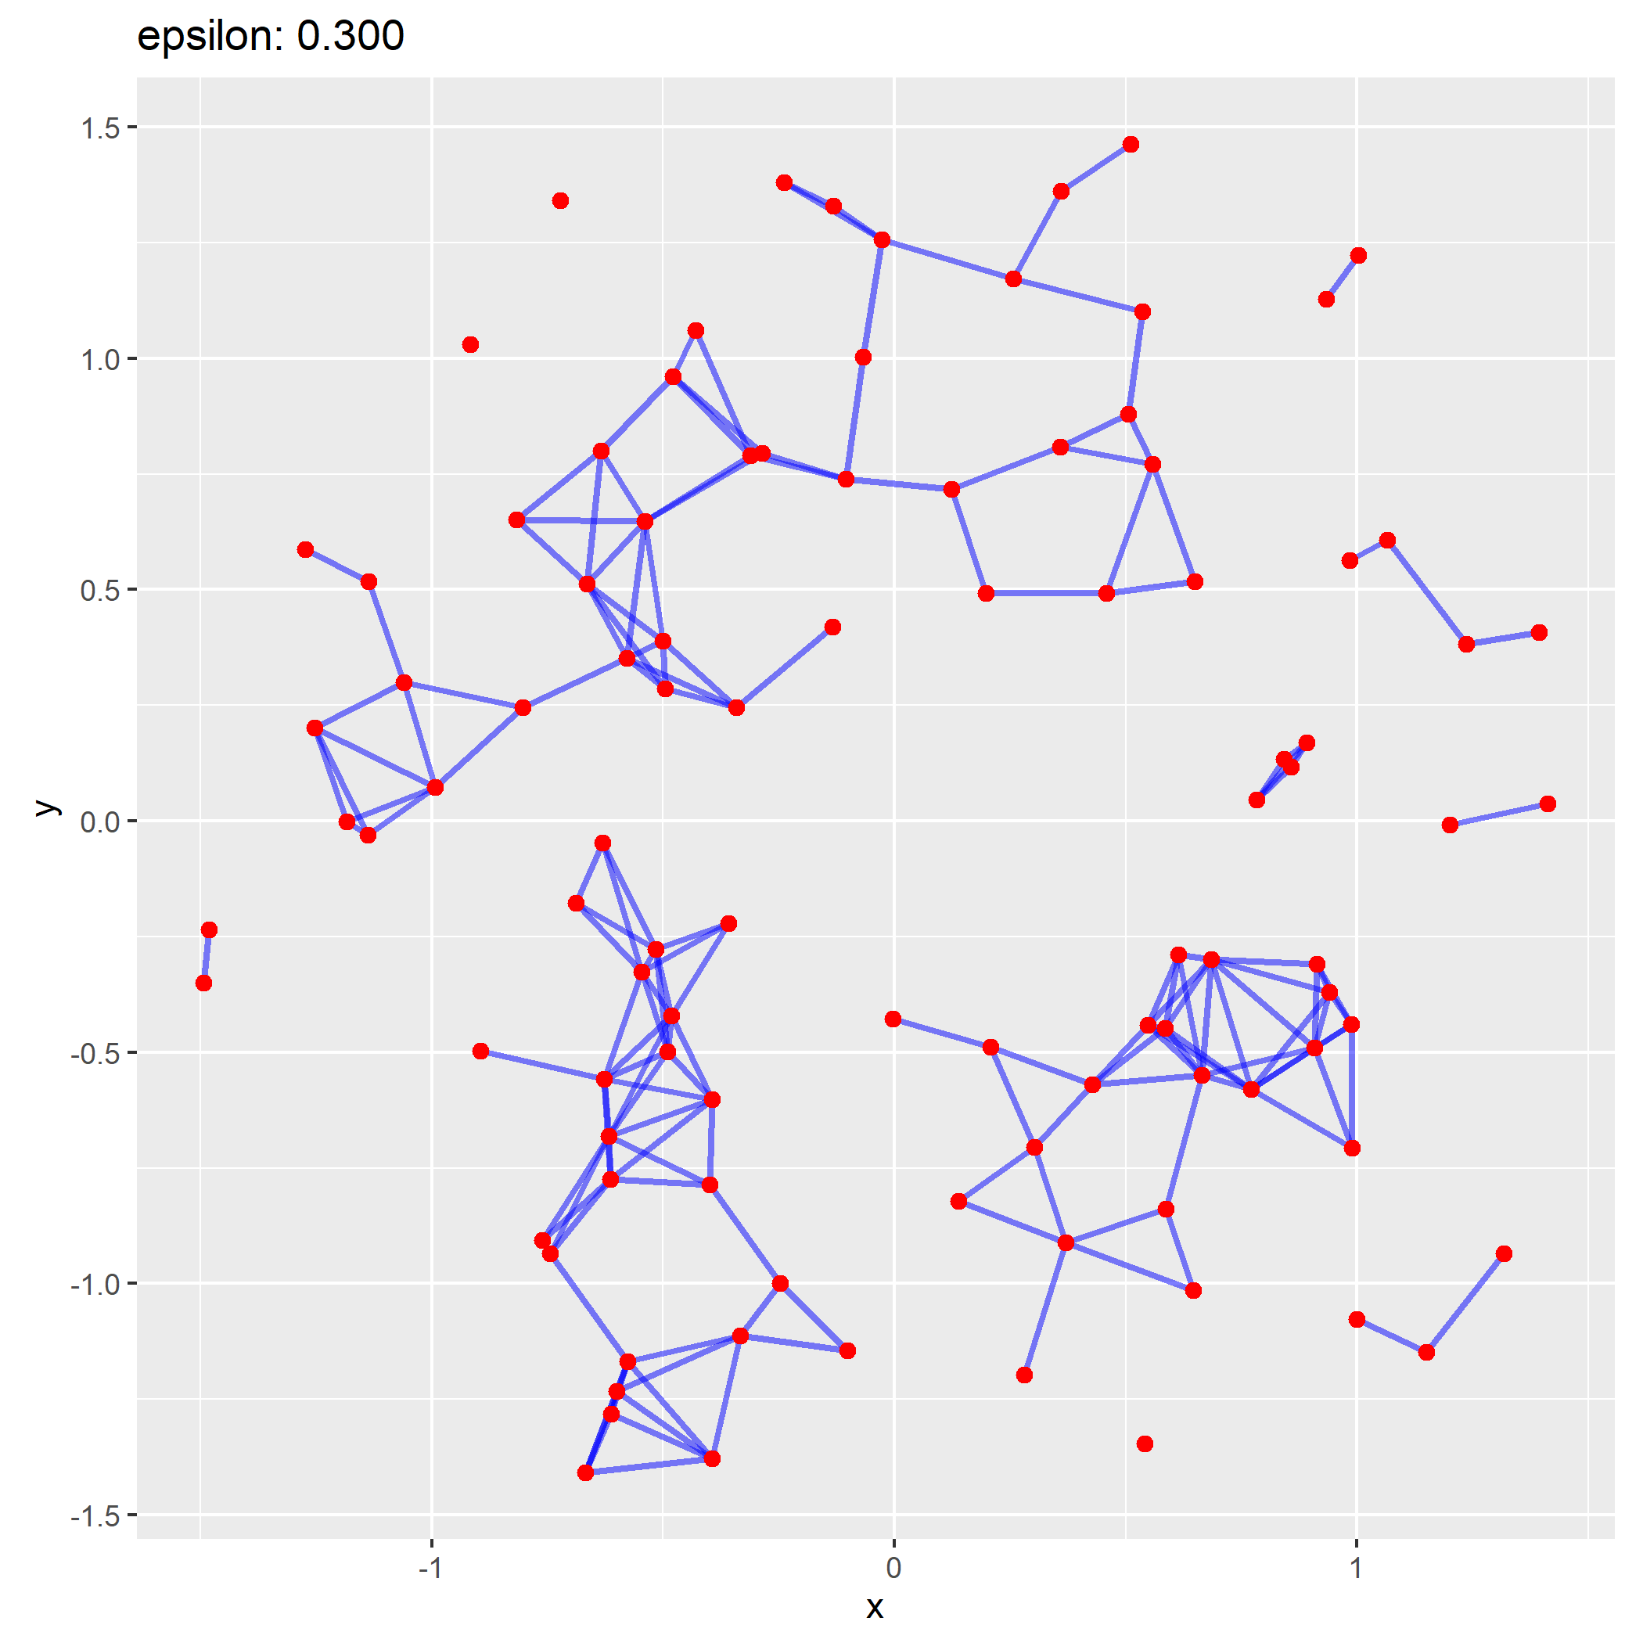

Slide 32

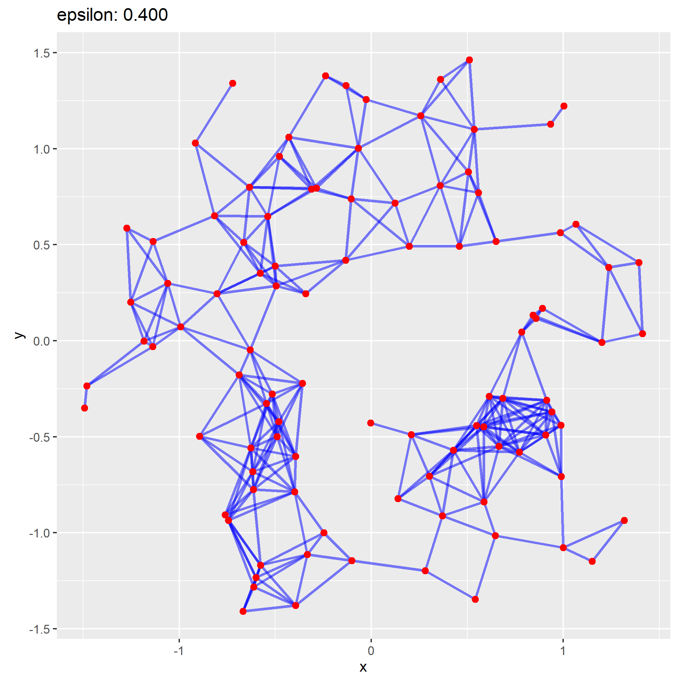

Slide 33

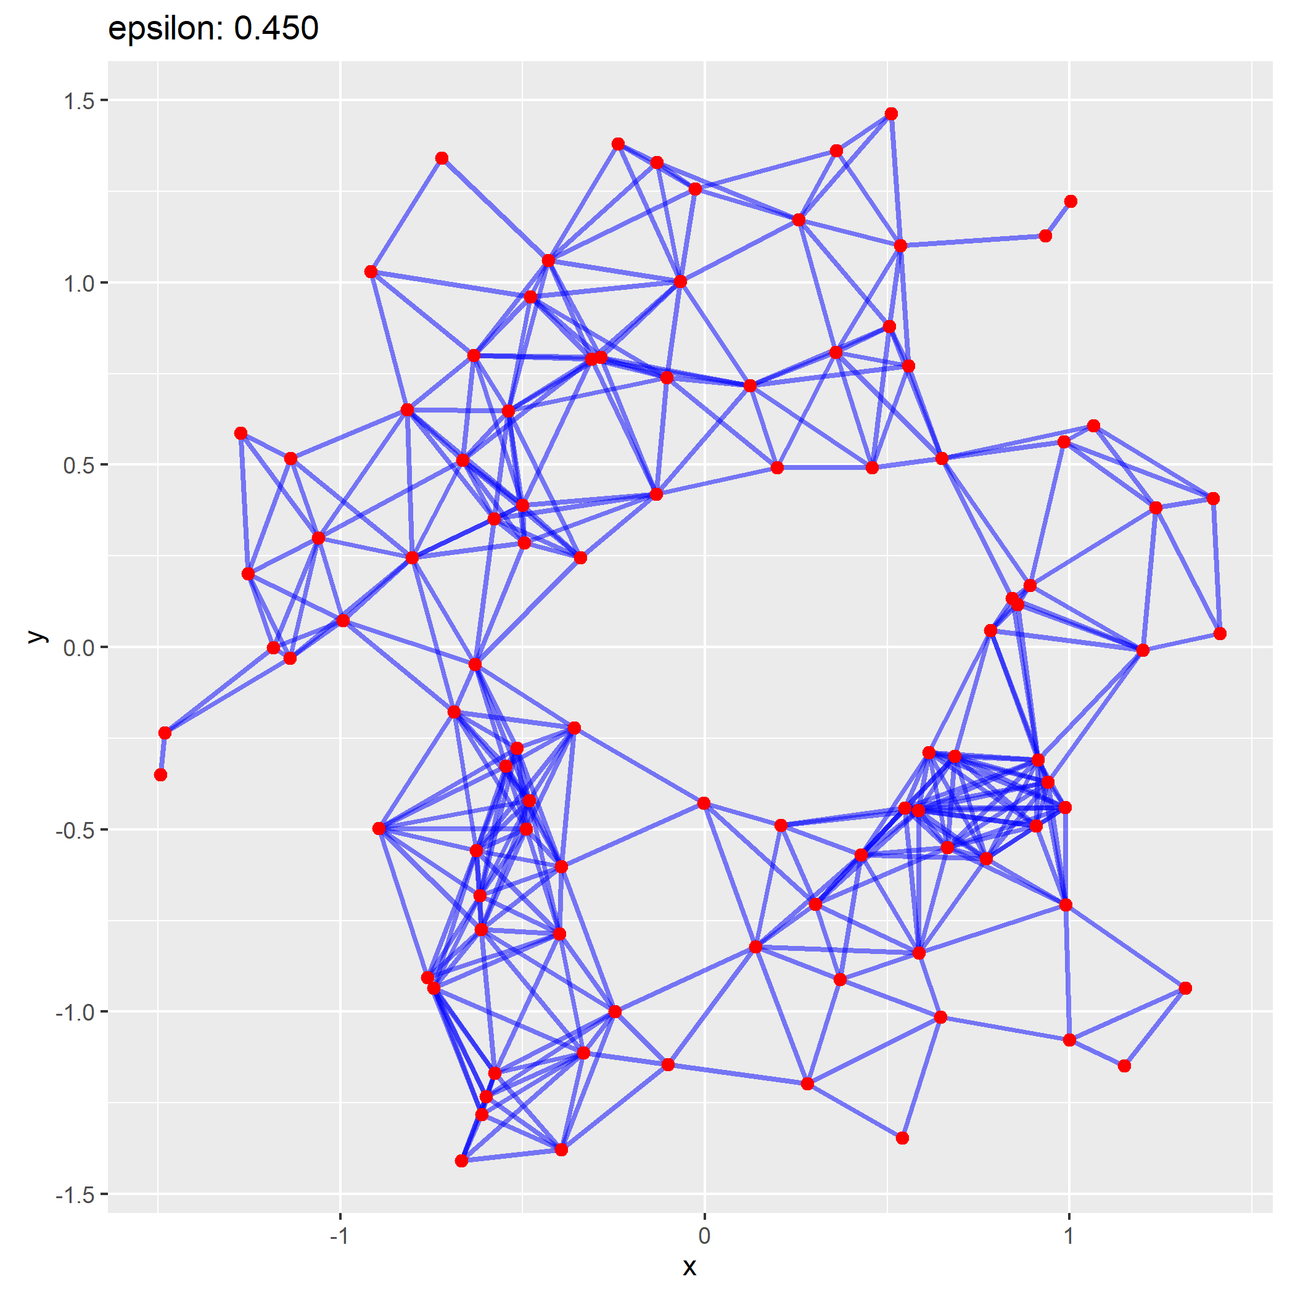

Slide 34

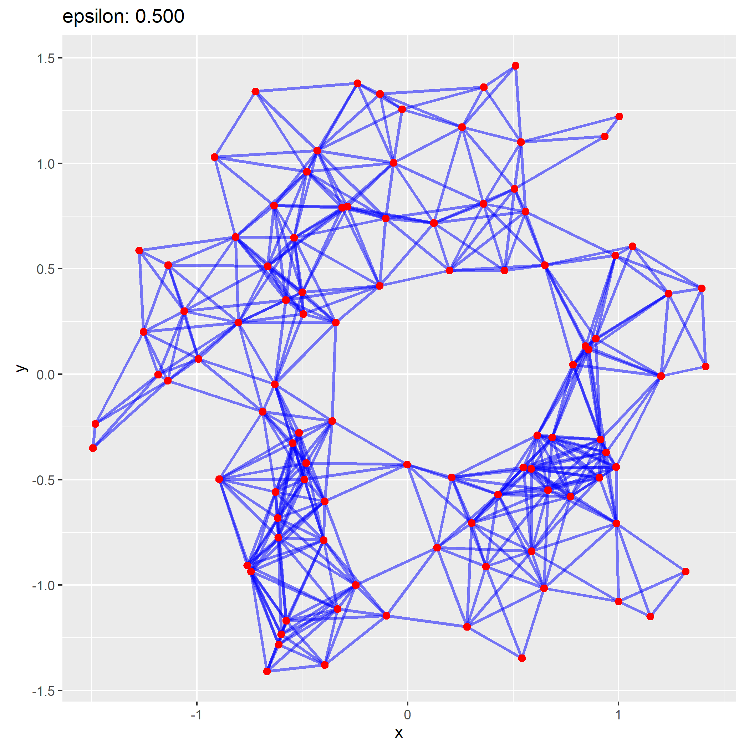

Slide 35
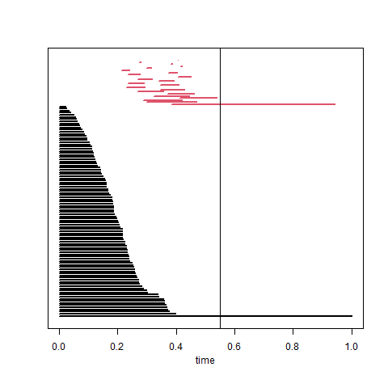
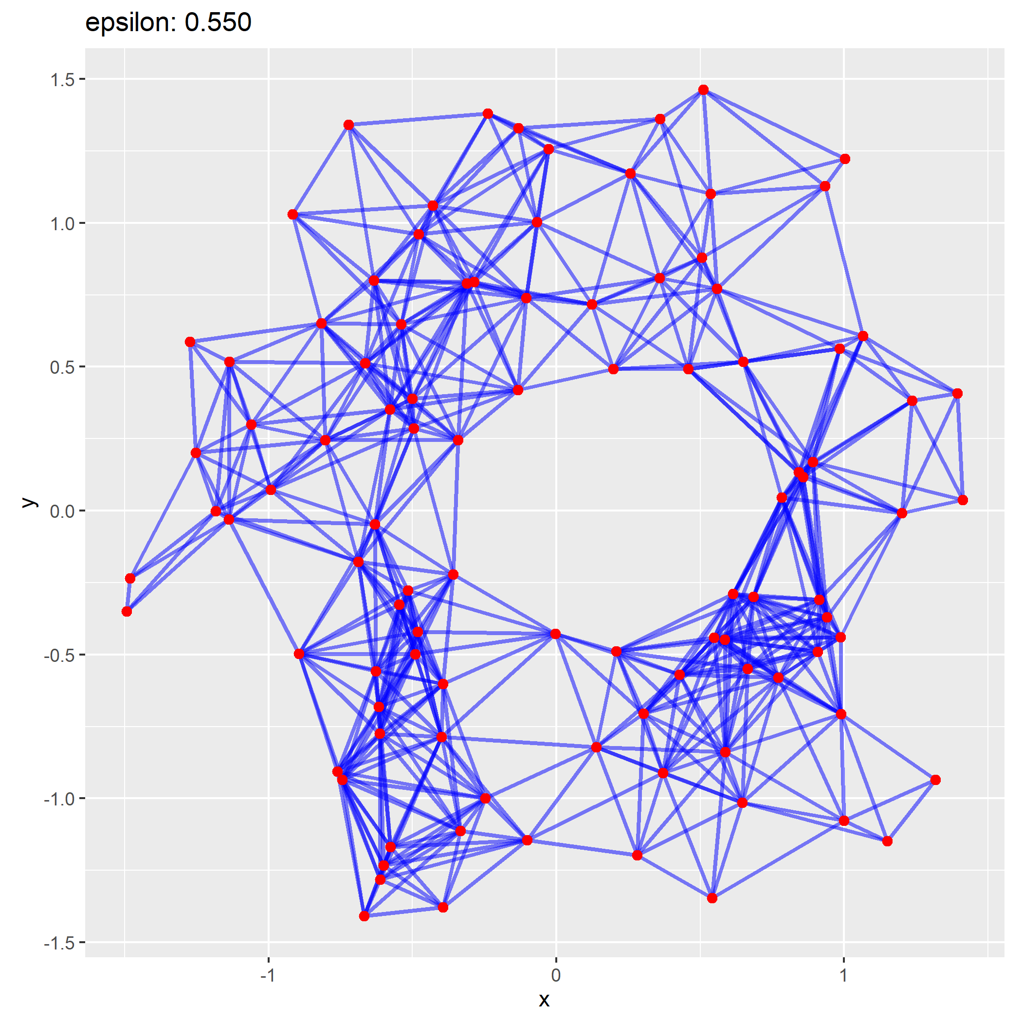

Slide 36

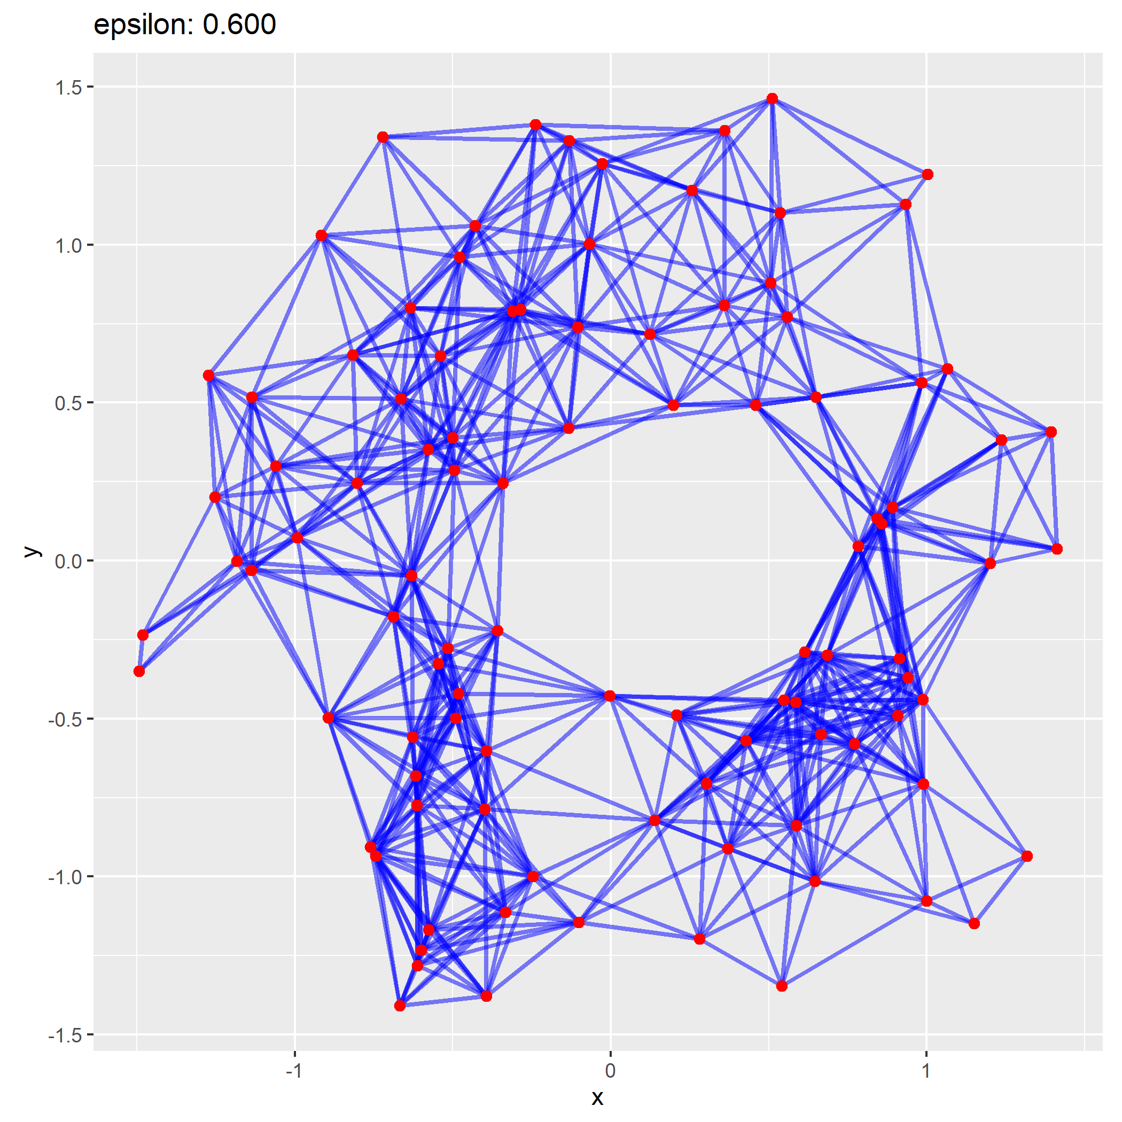

Slide 37

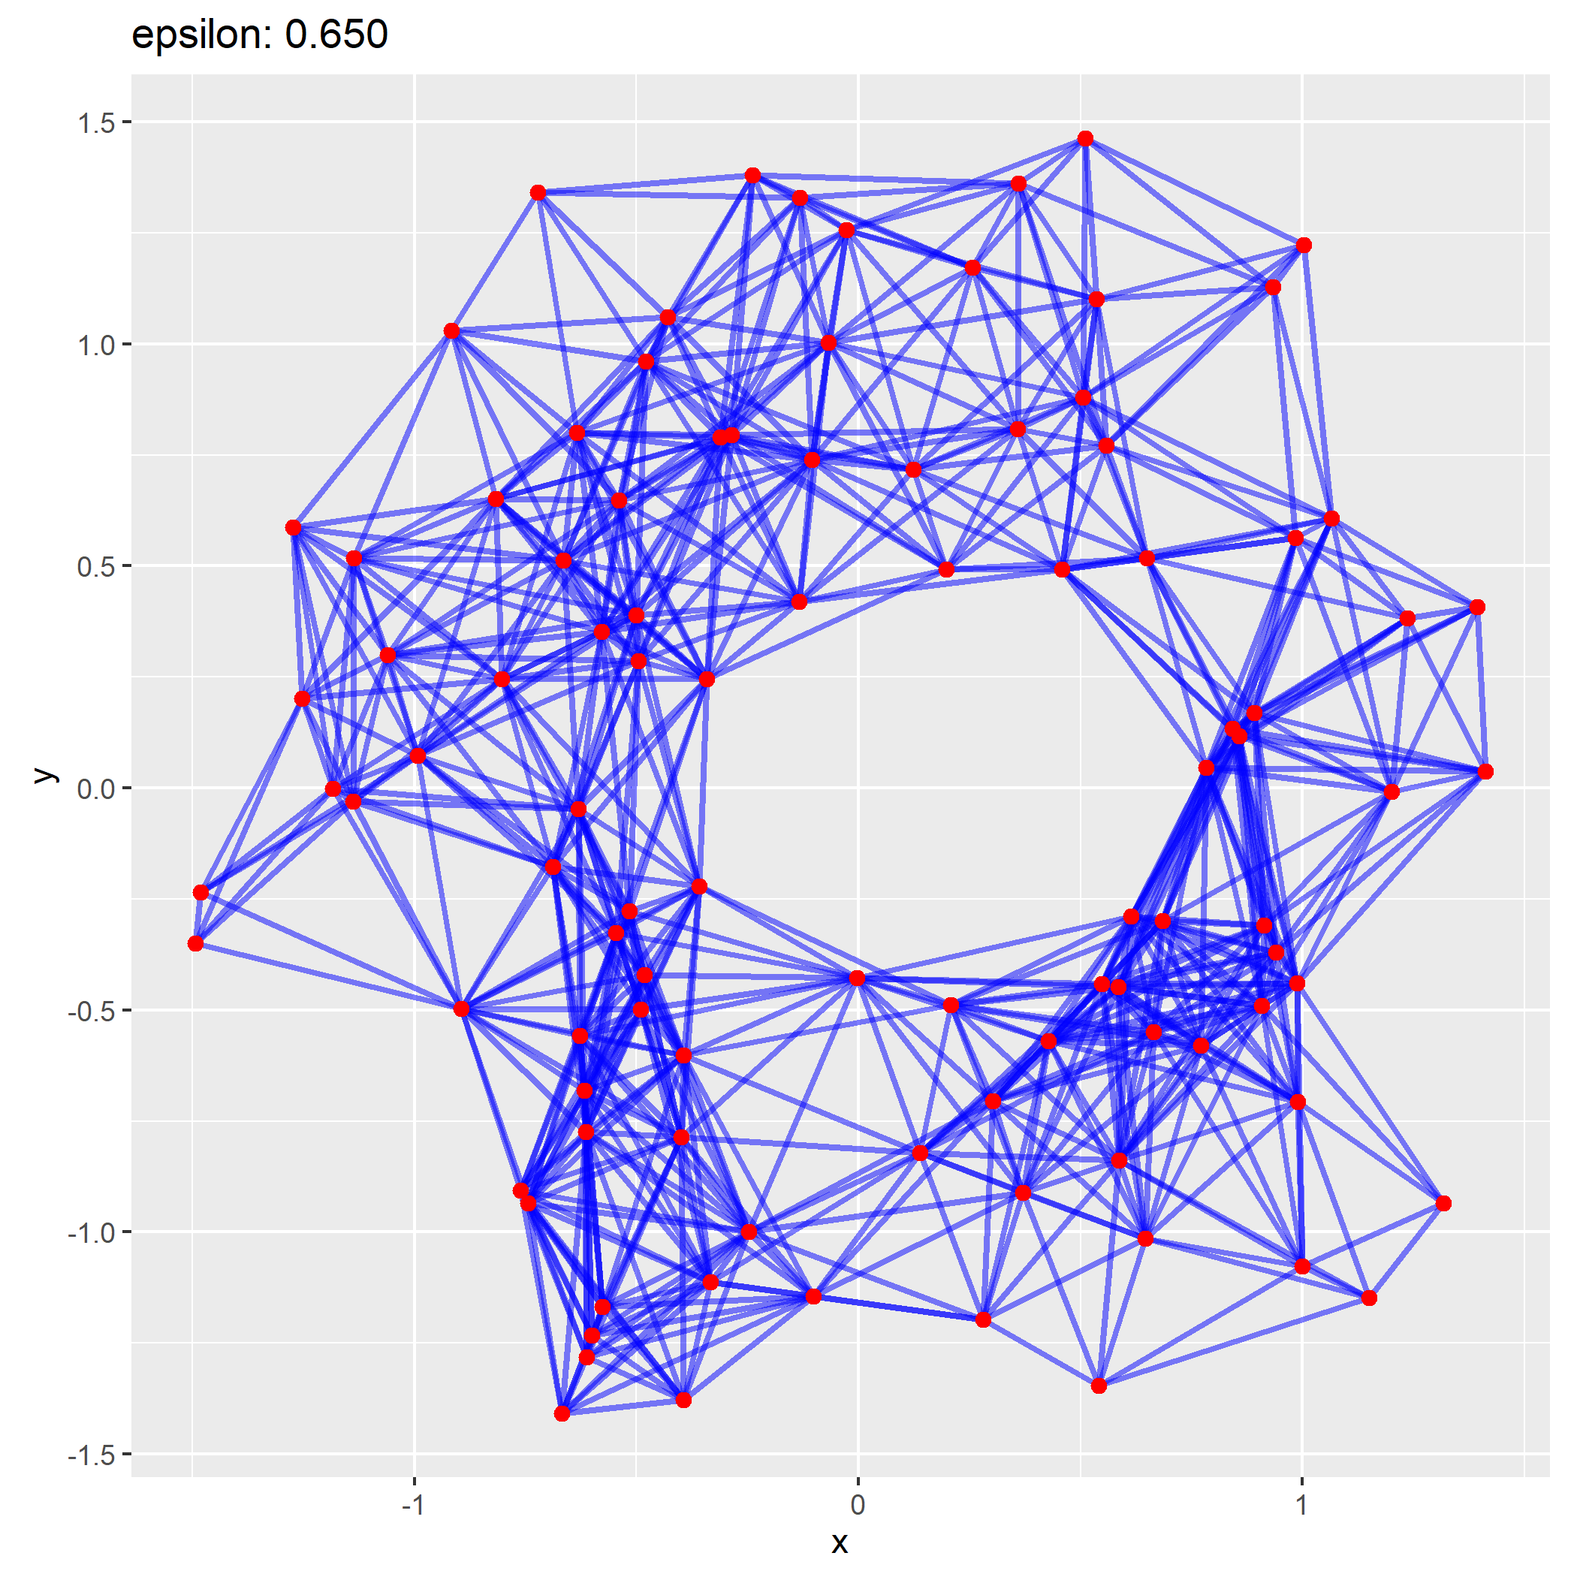

Slide 39

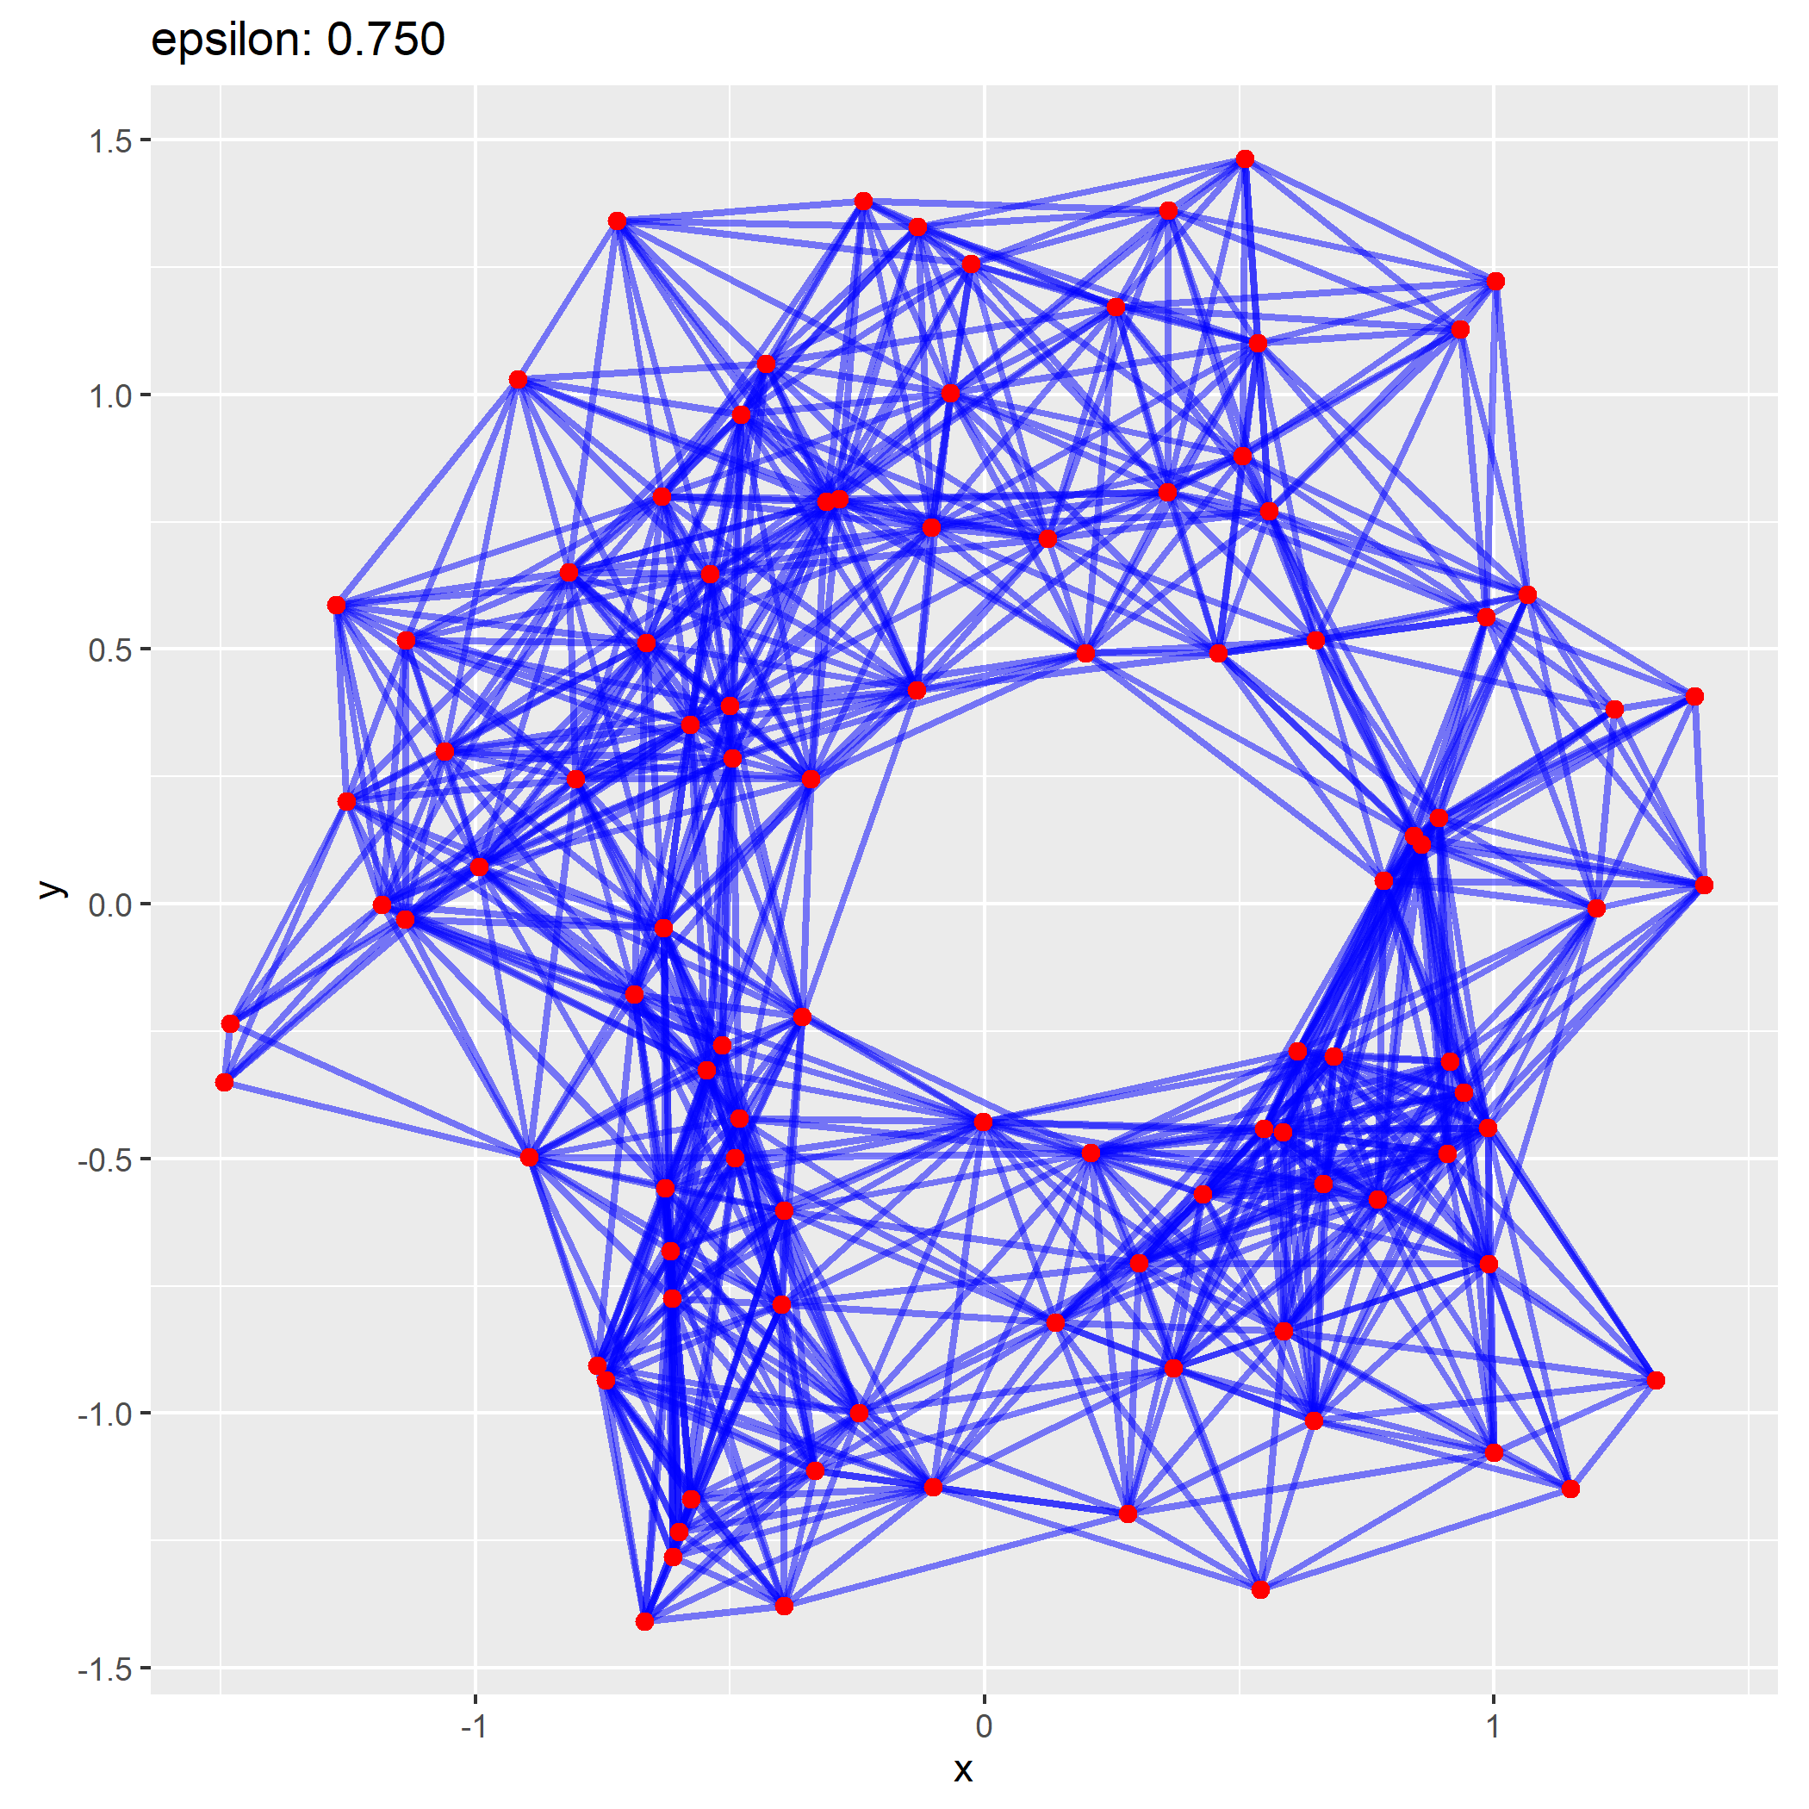

Slide 40

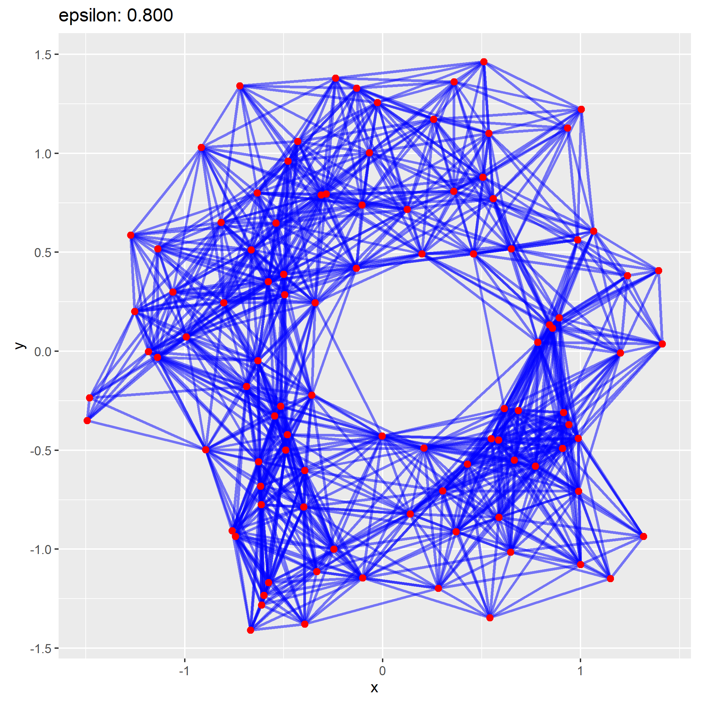

Slide 41

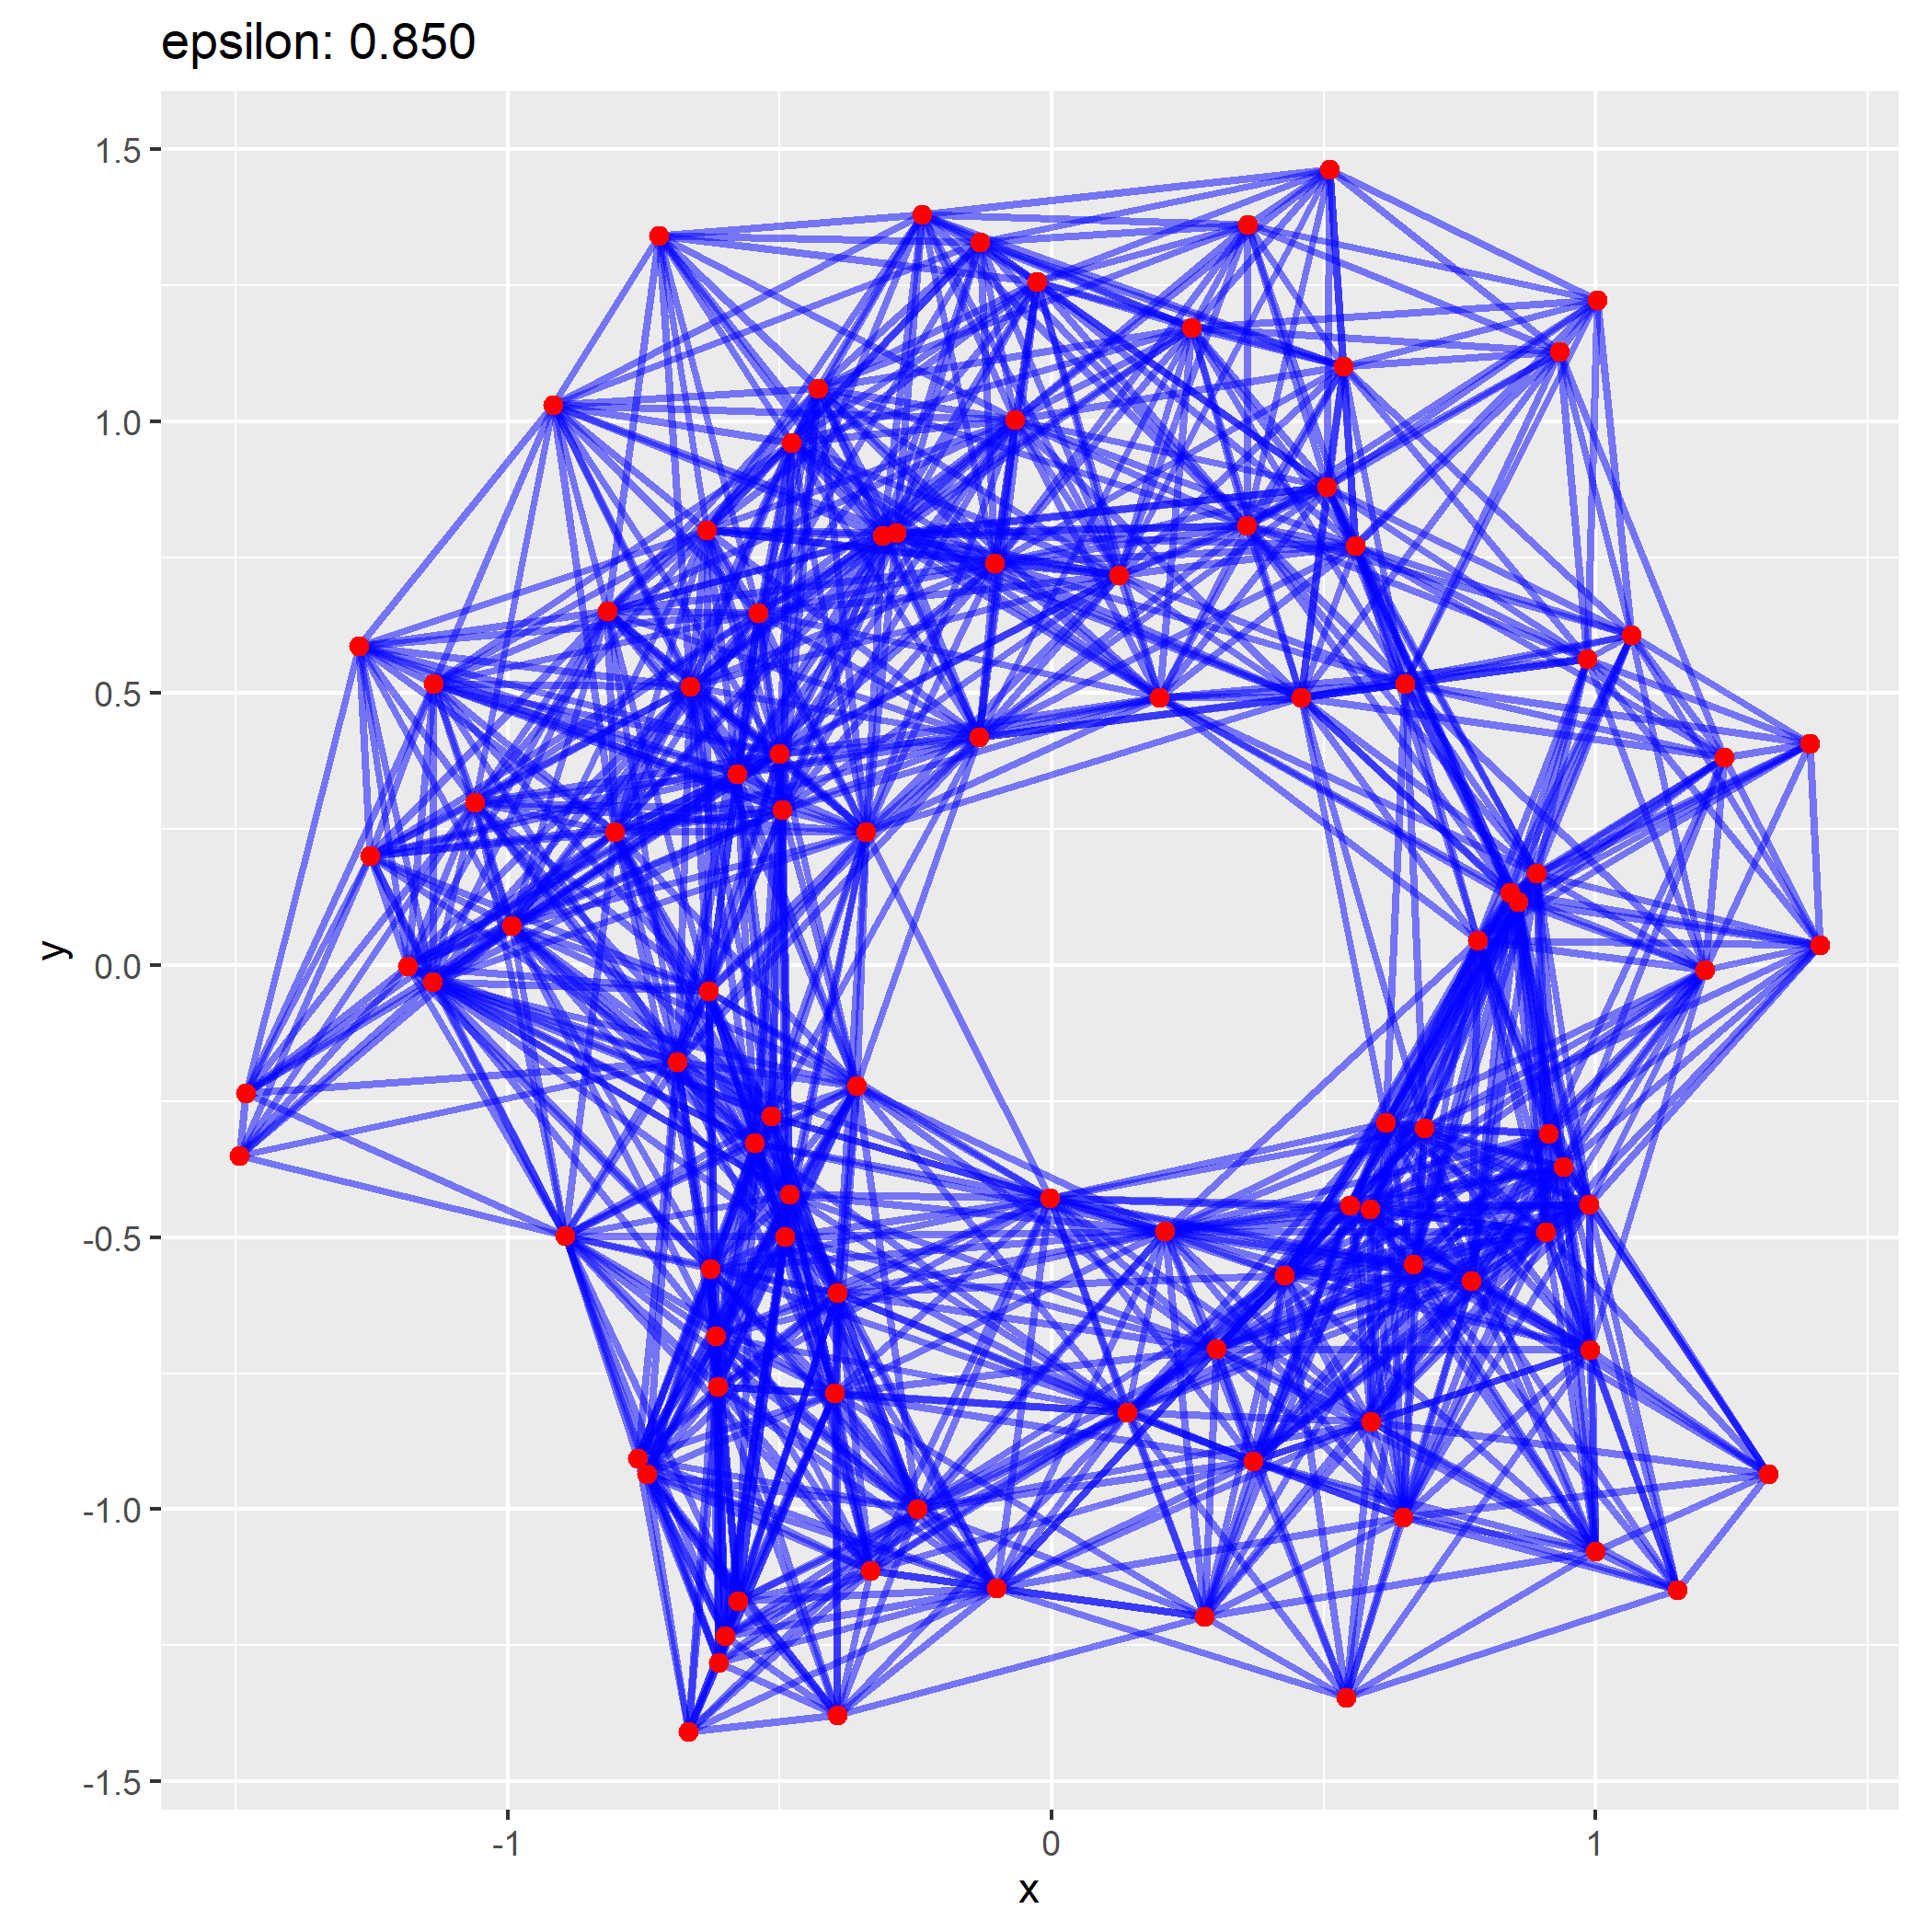

Slide 42

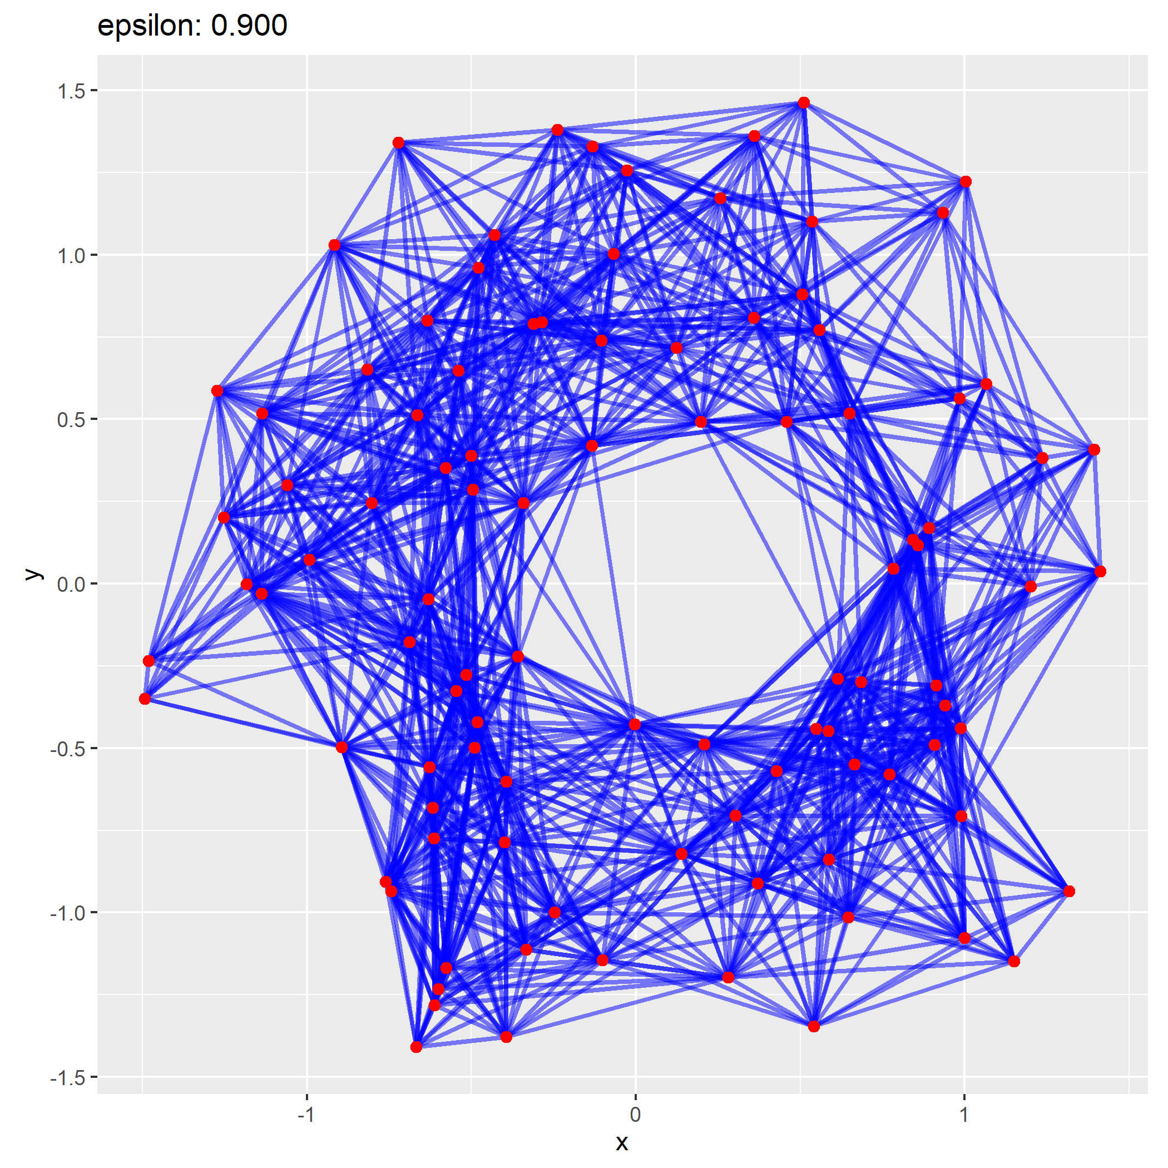

Slide 43

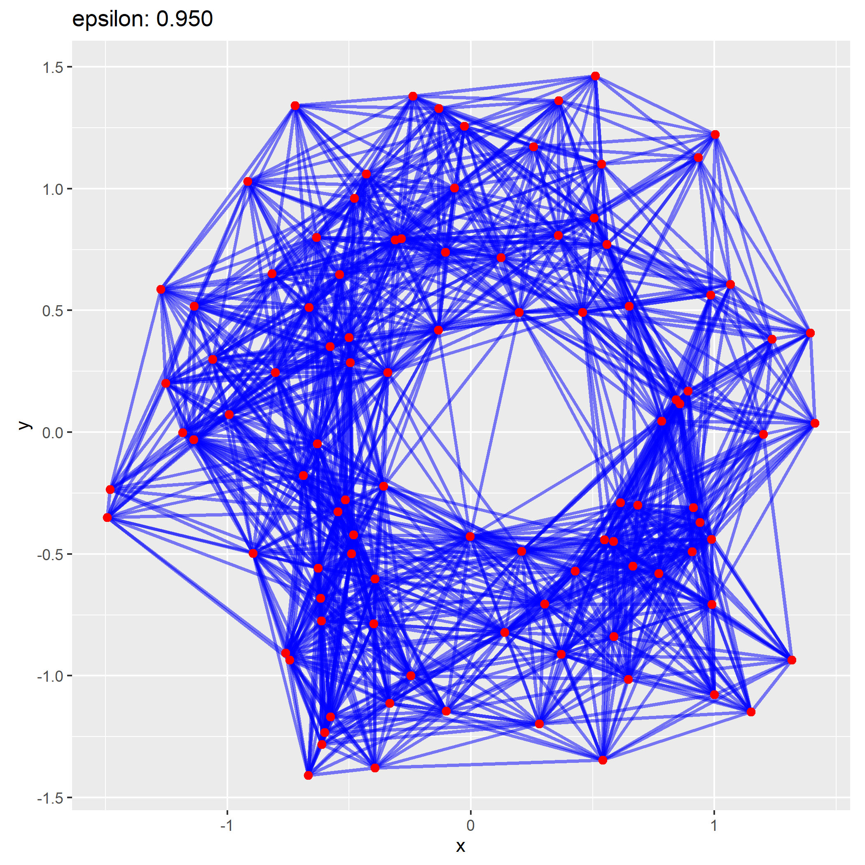

Slide 44

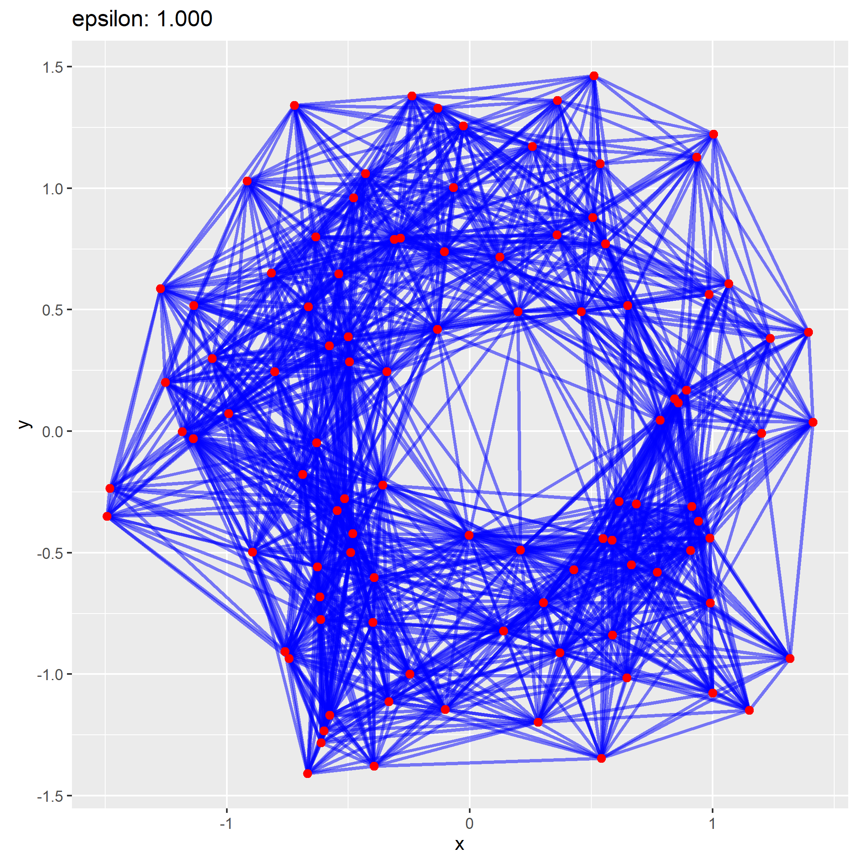

Slide 45
My project
A persistence diagram is heavily based on distance, how does metric impact it?
Investigate several constructed or contrived problems and observe the impacts of a metric on homological properties derived from the persistence diagram

Slide 46
So you have a 400-dimension torus

Slide 47
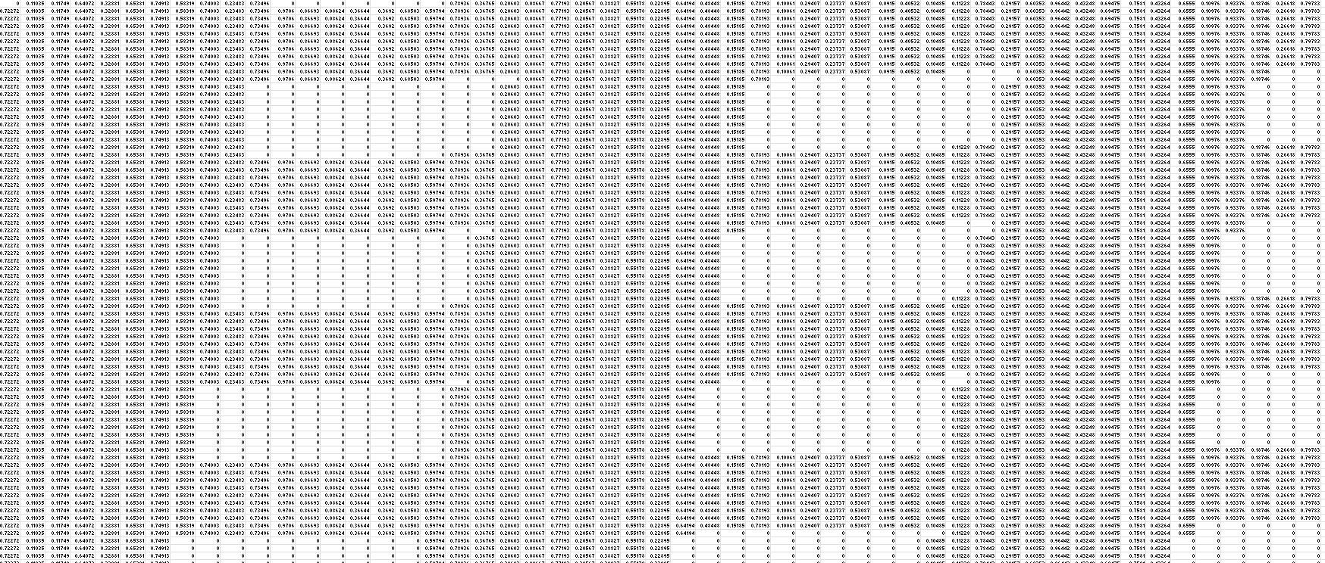
So you have a 400-dimension torus

Slide 48
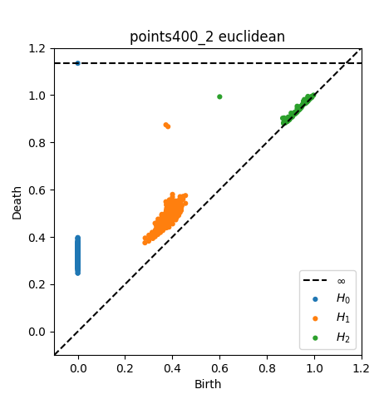
Persistence Diagrams by Metric

Slide 49
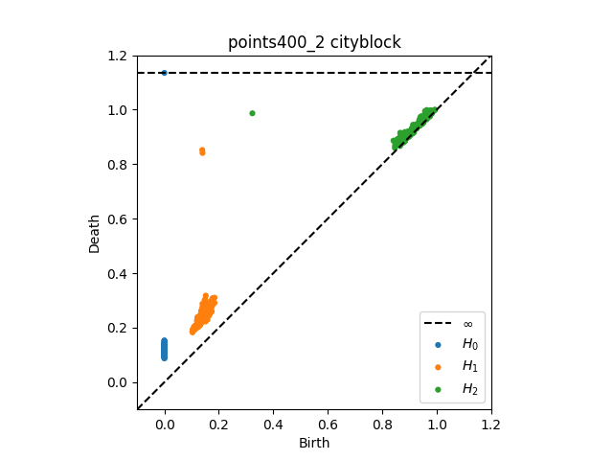
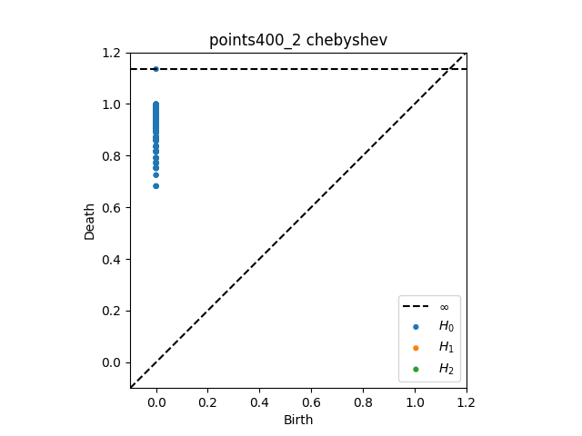
Persistence Diagrams by Metric

Slide 50
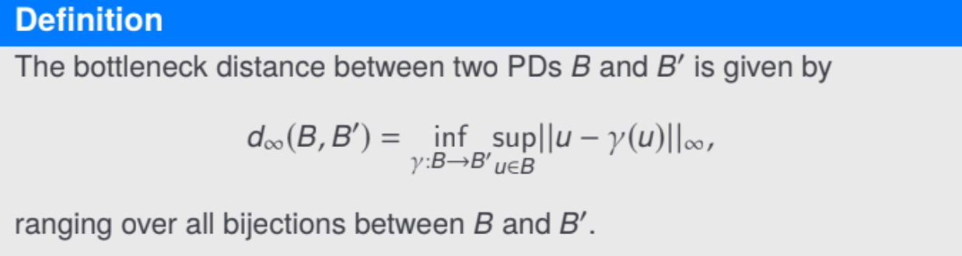
A metric between persistances??

Slide 51
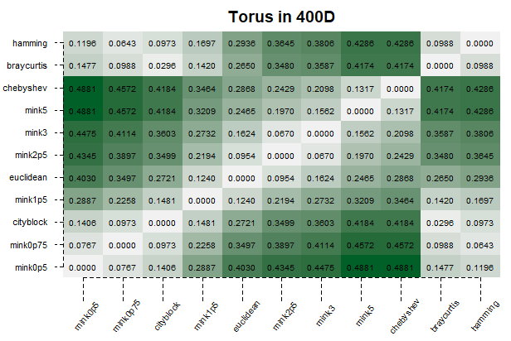
Distance table between persistances

Slide 52
What is topological data analysis really used for?
Breast cancer genome classification
Image analysis
Signal analysis
and more!
for fun :)
Database of Original and Non-theoretical Uses of Topology
https://donut.topology.rocks/

Slide 53
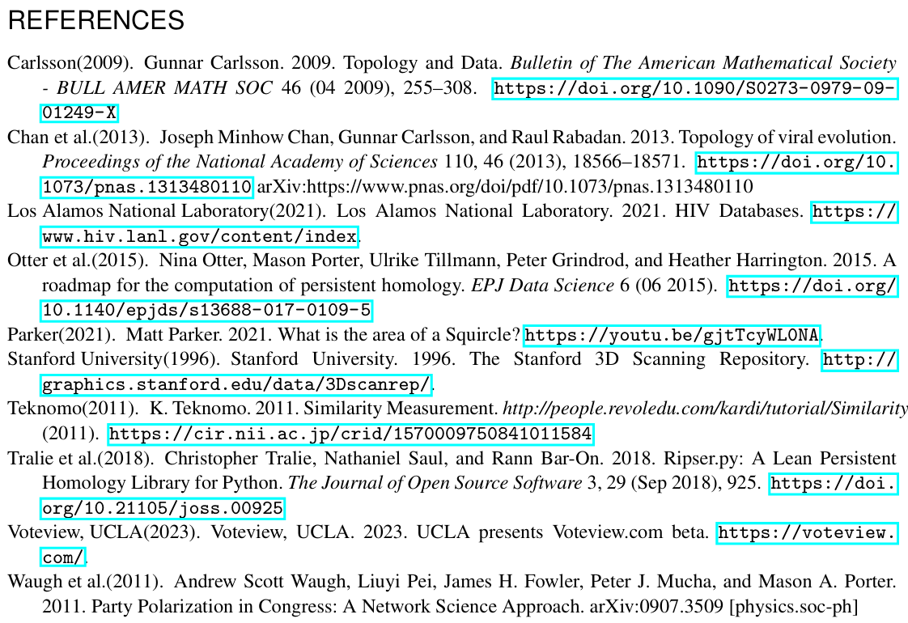
it is the end
Thank you to everyone for coming!
Any questions for the time remaining?

